Slide 1
Statistical Genetics
Lecture 2
Measures and Tests of Association

Slide 2
Lecture 2 Readings
Foulkes, A.S. (2009). Applied Statistical Genetics with R: Chapter 1, 2 & 3
Pahlke, F. (2010). Training in Genetic Epidemiology (www.wiley-vch.de/home/geneticepidemiology): Chapter 7
Zieger, A. & Konig, I.R. (2010). A Statistical Approach to Genetic Epidemiology: Chapter 10 & 11

Slide 3
Linkage Disequilibrium
Linkage disequilibrium (LD): defined as the association between two alleles.
LD can be measured in different ways, consider the following example
The case of two diallelic markers M1 and M2 with the alleles A and a at marker locus M1 and B and b at marker locus M2 having been genotyped in sample of n subjects (see the table below).
 |  | Marker M₂
 |  | BB | Bb | bb
Marker M₁ | AA | n_{AA,BB} | n_{AA,Bb} | n_{AA,bb} | n_{AA}
 | Aa | n_{Aa,BB} | n_{Aa,Bb} | n_{Aa,bb} | n_{Aa}
 | aa | n_{aa,BB} | n_{aa,Bb} | n_{aa,bb} | n_{aa}
 |  | n_{BB} | n_{Bb} | n_{bb} | n
Tab. 1: Genotype frequencies at loci M1 and M2.
Notes:
The genetic material that carries the instructions that allow cells to make proteins
Composed of a sugar phosphate backbone from which four nitrogenous bases- adenine (A), guanine (G), cytosine (C), and thymine (T) protrude
Arranged in a double helix- two strands are held together by specific pairings between bases A – T pair and G – C pair

Slide 4
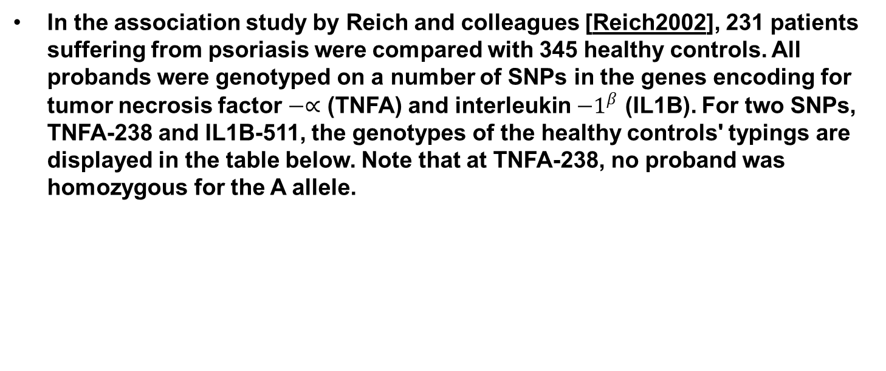
Example Association Study
In the association study by Reich and colleagues [Reich2002], 231 patients suffering from psoriasis were compared with 345 healthy controls. All probands were genotyped on a number of SNPs in the genes encoding for tumor necrosis factor $−∝$ (TNFA) and interleukin ${−1}^{β}$ (IL1B). For two SNPs, TNFA-238 and IL1B-511, the genotypes of the healthy controls' typings are displayed in the table below. Note that at TNFA-238, no proband was homozygous for the A allele.
 |  | TNFA-308 |  |  | Total
 |  | GG | GA | AA
TNFA-238 | GG | 213 | 99 | 4 | 316
 | GA | 25 | 4 | 0 | 29
 | Total | 238 | 103 | 4 | 345
Notes:
The genetic material that carries the instructions that allow cells to make proteins
Composed of a sugar phosphate backbone from which four nitrogenous bases- adenine (A), guanine (G), cytosine (C), and thymine (T) protrude
Arranged in a double helix- two strands are held together by specific pairings between bases A – T pair and G – C pair

Slide 5
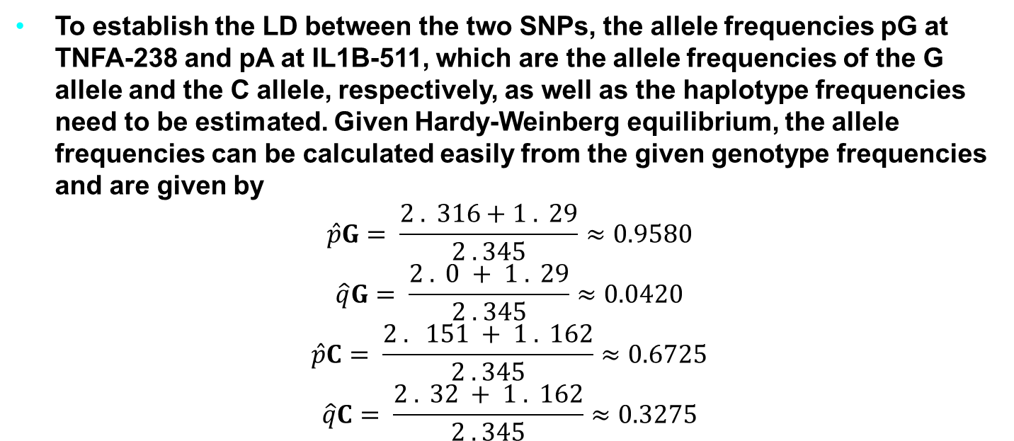
Example Association Study
To establish the LD between the two SNPs, the allele frequencies pG at TNFA-238 and pA at IL1B-511, which are the allele frequencies of the G allele and the C allele, respectively, as well as the haplotype frequencies need to be estimated. Given Hardy-Weinberg equilibrium, the allele frequencies can be calculated easily from the given genotype frequencies and are given by
$$\hat{p}G= \frac{2 . 316+1 . 29}{2 . 345}≈0.9580$$
$$\hat{q}G= \frac{2 . 0 + 1 . 29}{2 . 345}≈0.0420$$
$$\hat{p}C= \frac{2 . 151 + 1 . 162}{2 . 345}≈0.6725$$
$$\hat{q}C= \frac{2 . 32 + 1 . 162}{2 . 345}≈0.3275$$
Notes:
The genetic material that carries the instructions that allow cells to make proteins
Composed of a sugar phosphate backbone from which four nitrogenous bases- adenine (A), guanine (G), cytosine (C), and thymine (T) protrude
Arranged in a double helix- two strands are held together by specific pairings between bases A – T pair and G – C pair

Slide 6
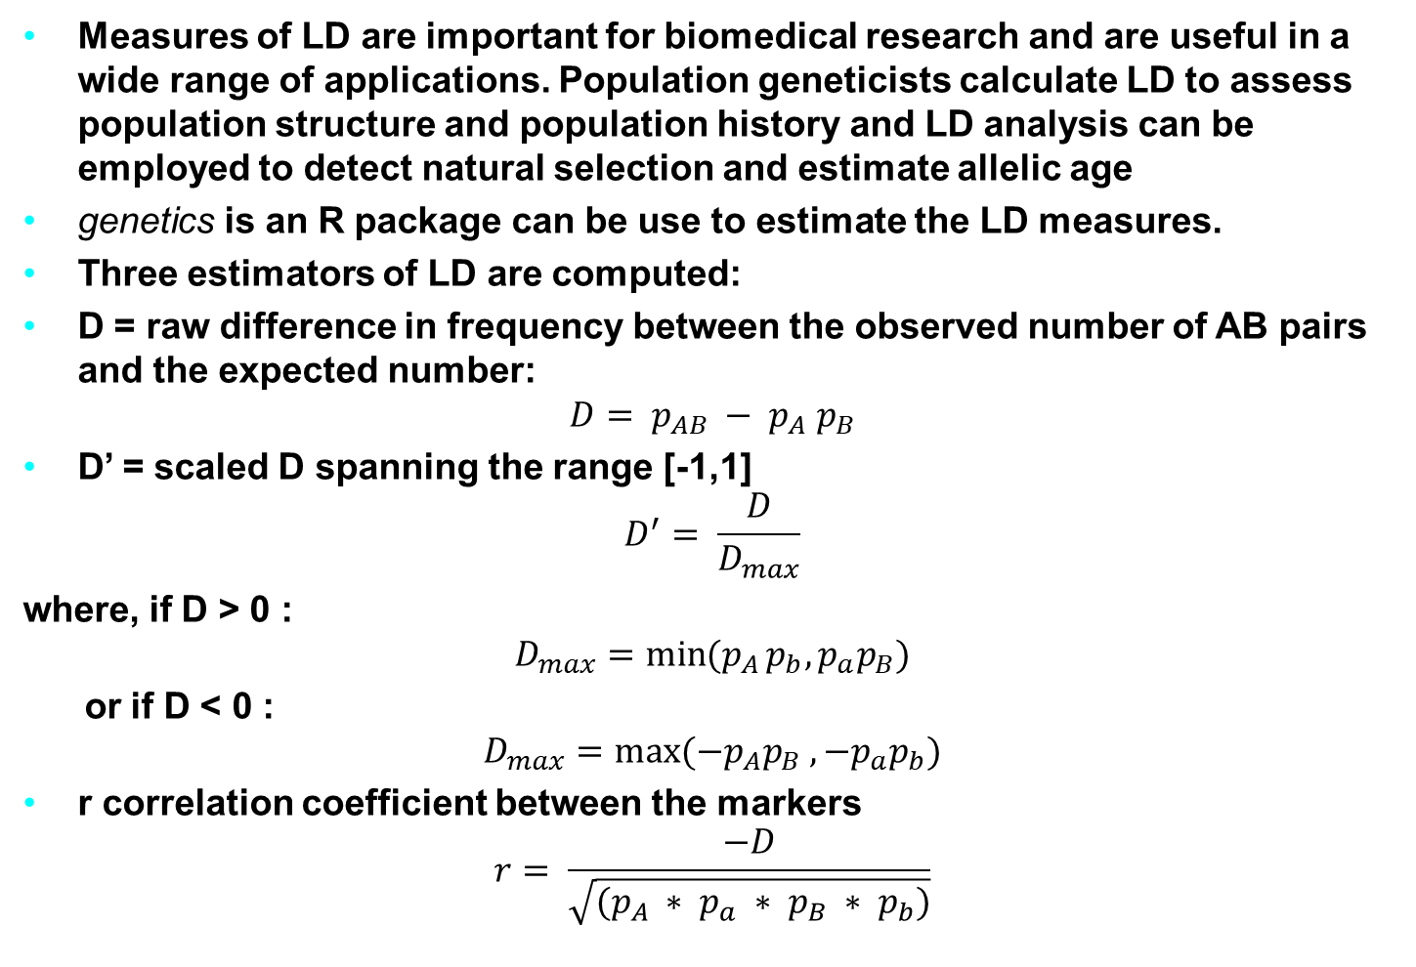
How to use R to estimate LD measures
Measures of LD are important for biomedical research and are useful in a wide range of applications. Population geneticists calculate LD to assess population structure and population history and LD analysis can be employed to detect natural selection and estimate allelic age
genetics is an R package can be use to estimate the LD measures.
Three estimators of LD are computed:
D = raw difference in frequency between the observed number of AB pairs and the expected number:
$$D= p_{AB} − p_{A} p_{B}$$
D’ = scaled D spanning the range [-1,1]
$$D^{′}= \frac{D}{D_{max}}$$
where, if D > 0 :
$$D_{max}=\min{(p_{A}}p_{b}, p_{a}p_{B})$$
or if D < 0 :
$$D_{max}=\max{(−p_{A}p_{B} , −p_{a}p_{b})}$$
r correlation coefficient between the markers
$$r= \frac{−D}{\sqrt{(p_{A} ∗ p_{a} ∗ p_{B} ∗ p_{b})}}$$
Notes:
The genetic material that carries the instructions that allow cells to make proteins
Composed of a sugar phosphate backbone from which four nitrogenous bases- adenine (A), guanine (G), cytosine (C), and thymine (T) protrude
Arranged in a double helix- two strands are held together by specific pairings between bases A – T pair and G – C pair

Slide 7
Example to estimate LD measures in R
Measures of LD are important for biomedical research and are useful in a wide range of applications. Population geneticists calculate LD to assess population structure and population history and LD analysis can be employed to detect natural selection and estimate allelic age
# NOT RUN {
g1 <- genotype( c('T/A', NA, 'T/T', NA, 'T/A', NA, 'T/T', 'T/A',
'T/T', 'T/T', 'T/A', 'A/A', 'T/T', 'T/A', 'T/A', 'T/T',
NA, 'T/A', 'T/A', NA) )
g2 <- genotype( c('C/A', 'C/A', 'C/C', 'C/A', 'C/C', 'C/A', 'C/A', 'C/A',
'C/A', 'C/C', 'C/A', 'A/A', 'C/A', 'A/A', 'C/A', 'C/C',
'C/A', 'C/A', 'C/A', 'A/A') )
g3 <- genotype( c('T/A', 'T/A', 'T/T', 'T/A', 'T/T', 'T/A', 'T/A', 'T/A',
'T/A', 'T/T', 'T/A', 'T/T', 'T/A', 'T/A', 'T/A', 'T/T',
'T/A', 'T/A', 'T/A', 'T/T') )
# Compute LD on a single pair
LD(g1,g2)
# Compute LD table for all 3 genotypes
data <- makeGenotypes(data.frame(g1,g2,g3))
LD(data)
Notes:
The genetic material that carries the instructions that allow cells to make proteins
Composed of a sugar phosphate backbone from which four nitrogenous bases- adenine (A), guanine (G), cytosine (C), and thymine (T) protrude
Arranged in a double helix- two strands are held together by specific pairings between bases A – T pair and G – C pair

Slide 8
Association for Unrelated Individuals
Here we described in detail the principle of genetic association as well as concepts and measures of linkage disequilibrium (LD).
We will focus on studies utilizing data from unrelated individuals in a case-control or a cohort study design.
The selection of individuals for an association study should be guided by the overall aim of the study. Basically, case-control and cohort studies are performed in three stages that can be distinguished:
In the first stage, one is interested in identifying genetic variants that are associated with the disease. Hence, one is interested in selecting cases and controls so as to maximize the effect of the genetic variant.
In the second stage, investigators may be interested in how different genetic and/or environmental factors act together and form the basis for a prognosis. Here, population-based studies may be preferred to the analysis of extreme groups.
The final stage is concerned with an exact quantification of the genetic risk of a genetic locus or a specific variant.
Because adjustments for sample selection are problematic, cohort studies are the design of choice. In the following, we focus on the first step, where a sample selection is performed to enrich the study groups for the disease-causing variant.
Notes:
The genetic material that carries the instructions that allow cells to make proteins
Composed of a sugar phosphate backbone from which four nitrogenous bases- adenine (A), guanine (G), cytosine (C), and thymine (T) protrude
Arranged in a double helix- two strands are held together by specific pairings between bases A – T pair and G – C pair

Slide 9
How can genetic association be tested?
Because even in a cohort study, affected individuals eventually will be compared with unaffecteds, for simplicity we will use the terms cases and controls regardless of the study design employed in this section.
The starting point for tests on genetic association is that a sample of cases and controls has been genotyped at a genetic marker. When considering a diallelic marker locus with alleles A and a, with a being the wild-type and A the mutated variant, the notation that will be used is shown in see the following table.
 | AA | aA | aa | Total
Cases | r₂ | r₁ | r₀ | r
Control | s₂ | s₁ | s₀ | s
Total | n₂ | n₁ | n₀ | n
Tab. 3: Observed genotype frequencies and theoretical probabilities in parenthesis for affected cases (a) and unaffected controls (u) at a diallelic marker.
Notes:
The genetic material that carries the instructions that allow cells to make proteins
Composed of a sugar phosphate backbone from which four nitrogenous bases- adenine (A), guanine (G), cytosine (C), and thymine (T) protrude
Arranged in a double helix- two strands are held together by specific pairings between bases A – T pair and G – C pair

Slide 10
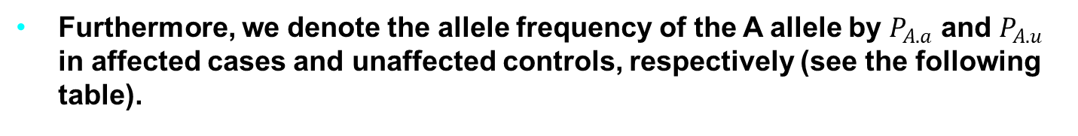
How can genetic association be tested?
Furthermore, we denote the allele frequency of the A allele by $P_{A.a}$ and $P_{A.u}$ in affected cases and unaffected controls, respectively (see the following table).
 | A | a | Total
Cases | 2r₂+r₁ | 2r₀ + r₁ | r
Control | 2r₂+r₁ | 2s₀ + s₁ | s
Total | 2n₂ + n₁ | 2n₀ + n₁ | 2n
Tab. 4: Observed allele frequencies and theoretical probabilities in parenthesis for cases and controls at a diallelic marker.
Notes:
The genetic material that carries the instructions that allow cells to make proteins
Composed of a sugar phosphate backbone from which four nitrogenous bases- adenine (A), guanine (G), cytosine (C), and thymine (T) protrude
Arranged in a double helix- two strands are held together by specific pairings between bases A – T pair and G – C pair

Slide 11
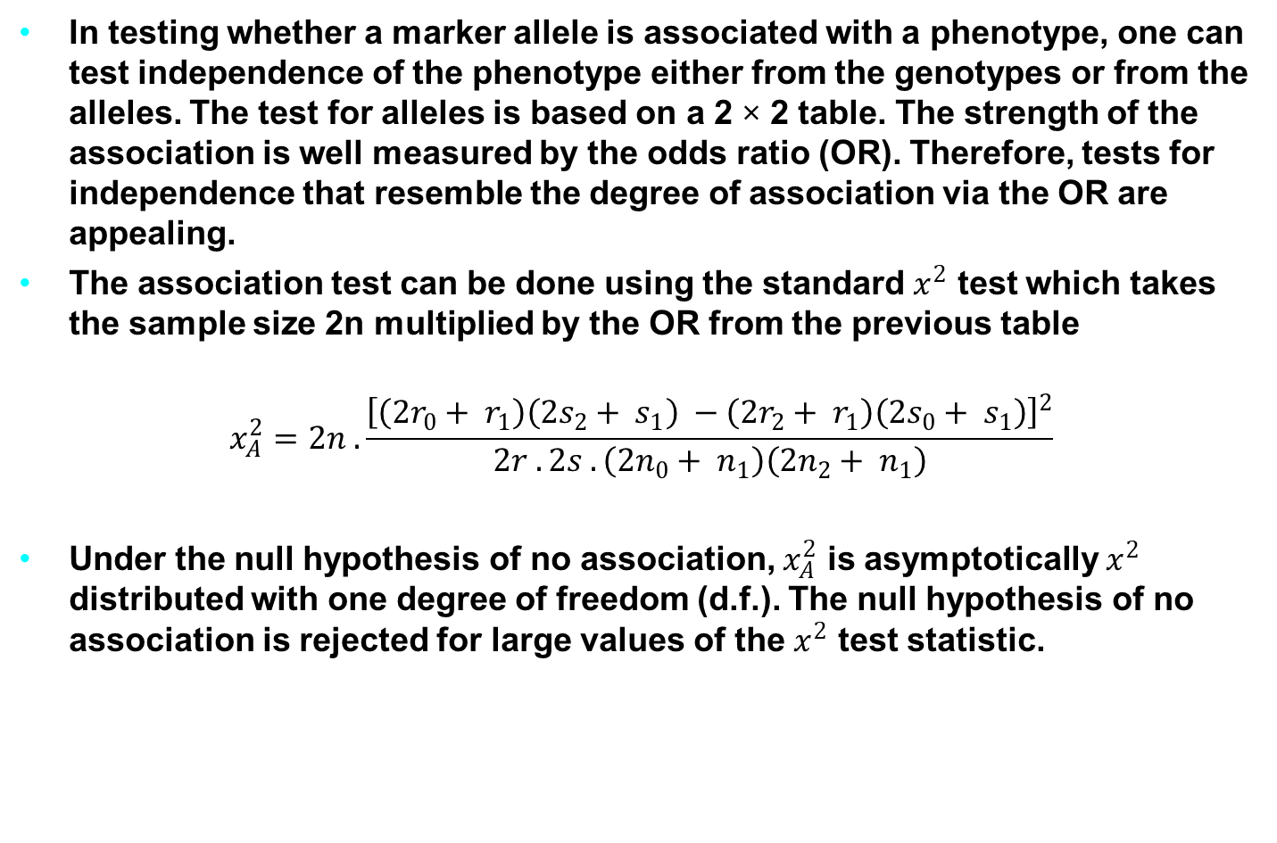
How can we test association between a marker allele and a phenotype?
In testing whether a marker allele is associated with a phenotype, one can test independence of the phenotype either from the genotypes or from the alleles. The test for alleles is based on a 2 × 2 table. The strength of the association is well measured by the odds ratio (OR). Therefore, tests for independence that resemble the degree of association via the OR are appealing.
The association test can be done using the standard $x^{2}$ test which takes the sample size 2n multiplied by the OR from the previous table
$$x_{A}^{2}=2n . \frac{{\left[\left({2r}_{0}+ r_{1}\right)\left({2s}_{2}+ s_{1}\right) −\left({2r}_{2}+ r_{1}\right)\left({2s}_{0}+ s_{1}\right)\right]}^{2}}{2r . 2s .\left({2n}_{0}+ n_{1}\right)\left({2n}_{2}+ n_{1}\right)}$$
Under the null hypothesis of no association, $x_{A}^{2}$ is asymptotically $x^{2}$ distributed with one degree of freedom (d.f.). The null hypothesis of no association is rejected for large values of the $x^{2}$ test statistic.
Notes:
The genetic material that carries the instructions that allow cells to make proteins
Composed of a sugar phosphate backbone from which four nitrogenous bases- adenine (A), guanine (G), cytosine (C), and thymine (T) protrude
Arranged in a double helix- two strands are held together by specific pairings between bases A – T pair and G – C pair

Slide 12
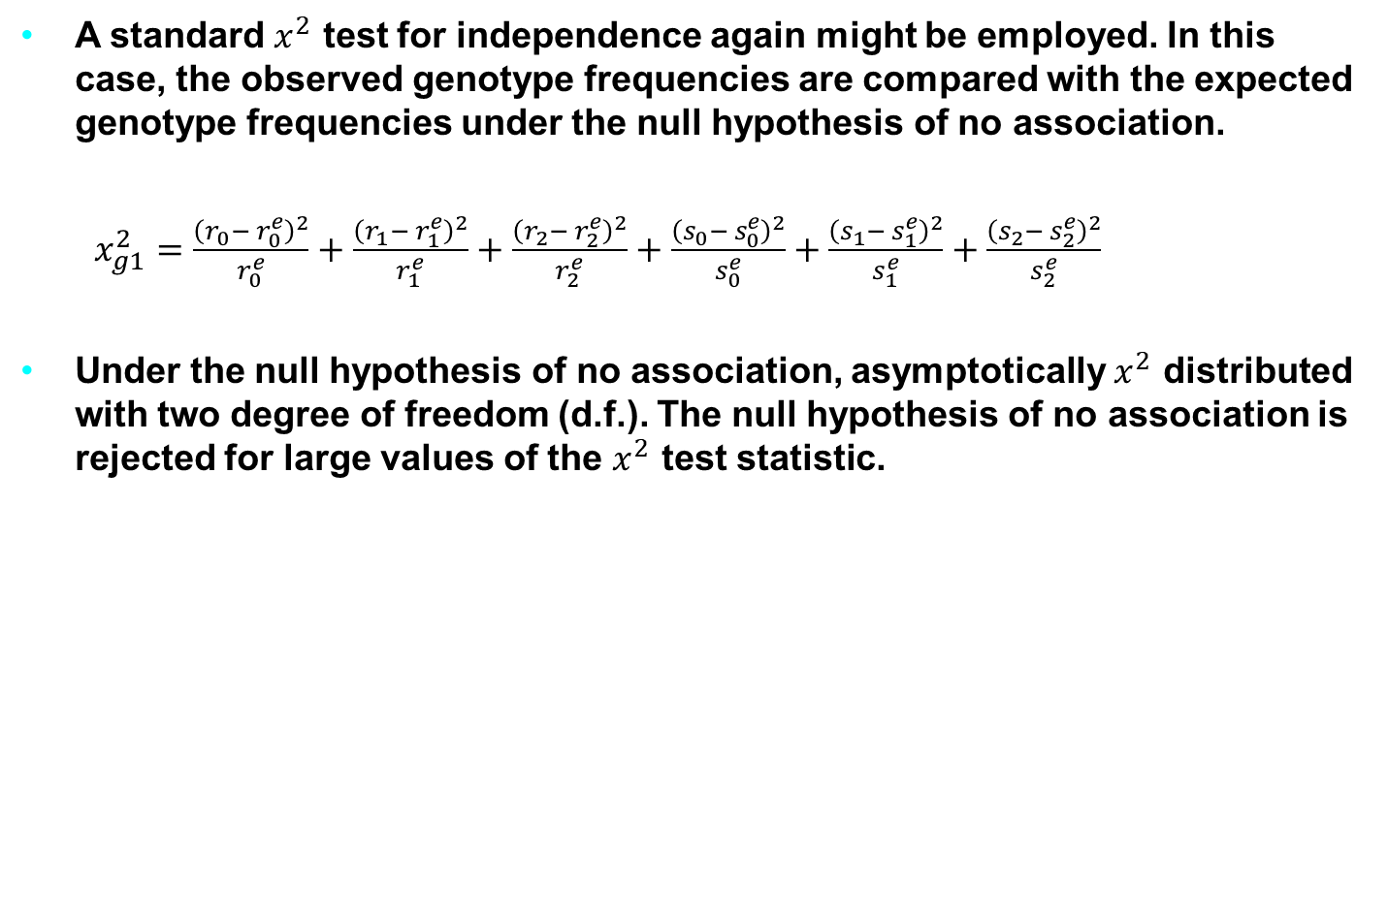
Standard Chi-Square test for Independence
A standard $x^{2}$ test for independence again might be employed. In this case, the observed genotype frequencies are compared with the expected genotype frequencies under the null hypothesis of no association.
$x_{g1}^{2}=\frac{{\left(r_{0}− r_{0}^{e}\right)}^{2}}{r_{0}^{e}}+\frac{{\left(r_{1}− r_{1}^{e}\right)}^{2}}{r_{1}^{e}}+\frac{{\left(r_{2}− r_{2}^{e}\right)}^{2}}{r_{2}^{e}}+\frac{{\left(s_{0}− s_{0}^{e}\right)}^{2}}{s_{0}^{e}}+\frac{{\left(s_{1}− s_{1}^{e}\right)}^{2}}{s_{1}^{e}}+\frac{{\left(s_{2}− s_{2}^{e}\right)}^{2}}{s_{2}^{e}}$
Under the null hypothesis of no association, asymptotically $x^{2}$ distributed with two degree of freedom (d.f.). The null hypothesis of no association is rejected for large values of the $x^{2}$ test statistic.
Notes:
The genetic material that carries the instructions that allow cells to make proteins
Composed of a sugar phosphate backbone from which four nitrogenous bases- adenine (A), guanine (G), cytosine (C), and thymine (T) protrude
Arranged in a double helix- two strands are held together by specific pairings between bases A – T pair and G – C pair

Slide 13
How can genetic association be tested?
Genetic association tests depend on the underlying genetic model that is assumed.
These are: dominant model, recessive model, additive and over dominant model.
Dominant model: A genetic association analysis mode that examines association with a dominant allele. The comparison groups are wild-type homozygous genotypes vs allele positivity (combining heterozygotes and homozygotes for the variant).
Recessive model: A genetic association analysis mode that examines association with a recessive allele. The comparison groups are variant homozygous genotypes vs the rest (combining heterozygotes for the variant and homozygotes for the wild-type allele).
Notes:
The genetic material that carries the instructions that allow cells to make proteins
Composed of a sugar phosphate backbone from which four nitrogenous bases- adenine (A), guanine (G), cytosine (C), and thymine (T) protrude
Arranged in a double helix- two strands are held together by specific pairings between bases A – T pair and G – C pair

Slide 14
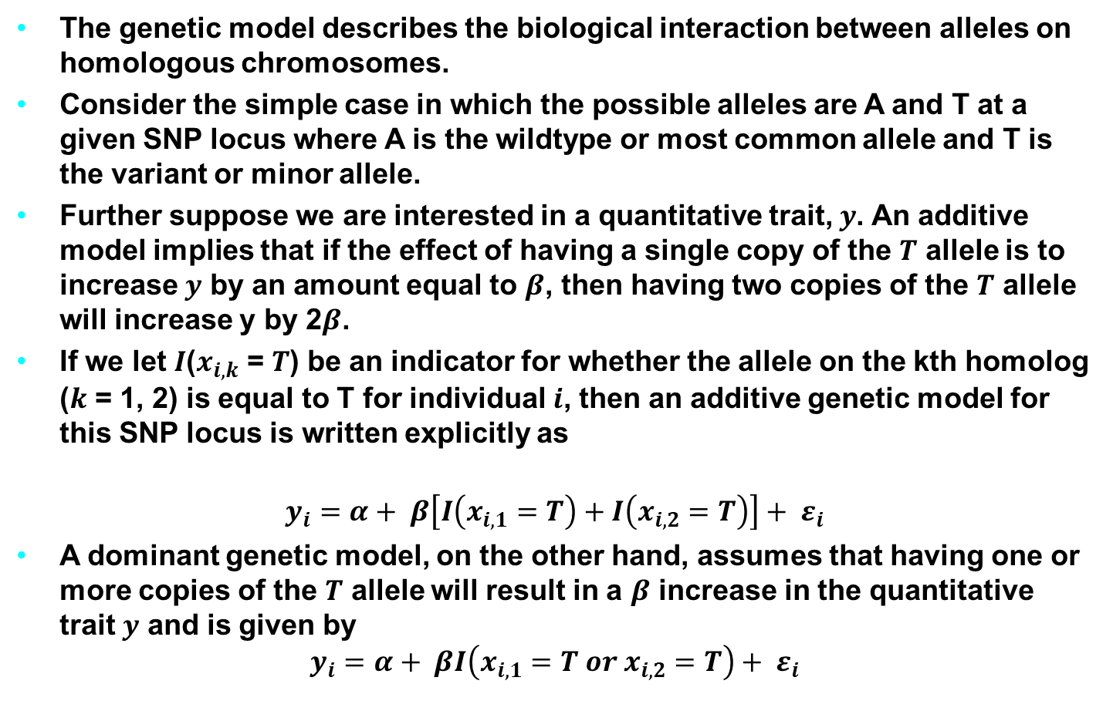
Genetic Models
The genetic model describes the biological interaction between alleles on homologous chromosomes.
Consider the simple case in which the possible alleles are A and T at a given SNP locus where A is the wildtype or most common allele and T is the variant or minor allele.
Further suppose we are interested in a quantitative trait, $y$. An additive model implies that if the effect of having a single copy of the $T$ allele is to increase $y$ by an amount equal to $β$, then having two copies of the $T$ allele will increase y by 2$β$.
If we let $I$($x_{i,k}$ = $T$) be an indicator for whether the allele on the kth homolog ($k$ = 1, 2) is equal to T for individual $i$, then an additive genetic model for this SNP locus is written explicitly as
$$y_{i}=α+ β\left[I\left(x_{i,1}=T\right)+I\left(x_{i,2}=T\right)\right]+ ε_{i}$$
A dominant genetic model, on the other hand, assumes that having one or more copies of the $T$ allele will result in a $β$ increase in the quantitative trait $y$ and is given by
$$y_{i}=α+ βI\left(x_{i,1}=T or x_{i,2}=T\right)+ ε_{i}$$
Notes:
The genetic material that carries the instructions that allow cells to make proteins
Composed of a sugar phosphate backbone from which four nitrogenous bases- adenine (A), guanine (G), cytosine (C), and thymine (T) protrude
Arranged in a double helix- two strands are held together by specific pairings between bases A – T pair and G – C pair

Slide 15
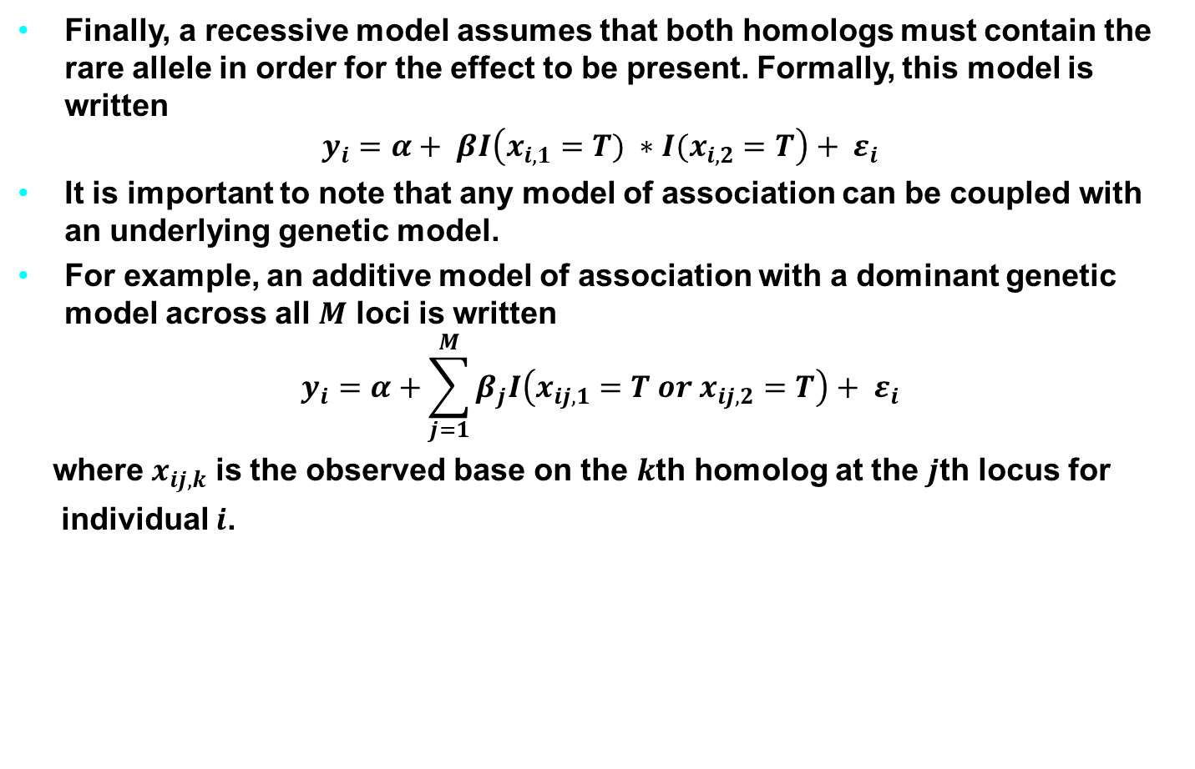
Genetic Models
Finally, a recessive model assumes that both homologs must contain the rare allele in order for the effect to be present. Formally, this model is written
$$y_{i}=α+ βI\left(x_{i,1}=T) ∗I(x_{i,2}=T\right)+ ε_{i}$$
It is important to note that any model of association can be coupled with an underlying genetic model.
For example, an additive model of association with a dominant genetic model across all $M$ loci is written
$$y_{i}=α+\sum_{j=1}^{M}{β_{j}I\left(x_{ij,1}=T or x_{ij,2}=T\right)+ ε_{i}}$$
where $x_{ij,k}$ is the observed base on the $k$th homolog at the $j$th locus for
individual $i$.
Notes:
The genetic material that carries the instructions that allow cells to make proteins
Composed of a sugar phosphate backbone from which four nitrogenous bases- adenine (A), guanine (G), cytosine (C), and thymine (T) protrude
Arranged in a double helix- two strands are held together by specific pairings between bases A – T pair and G – C pair

Slide 16
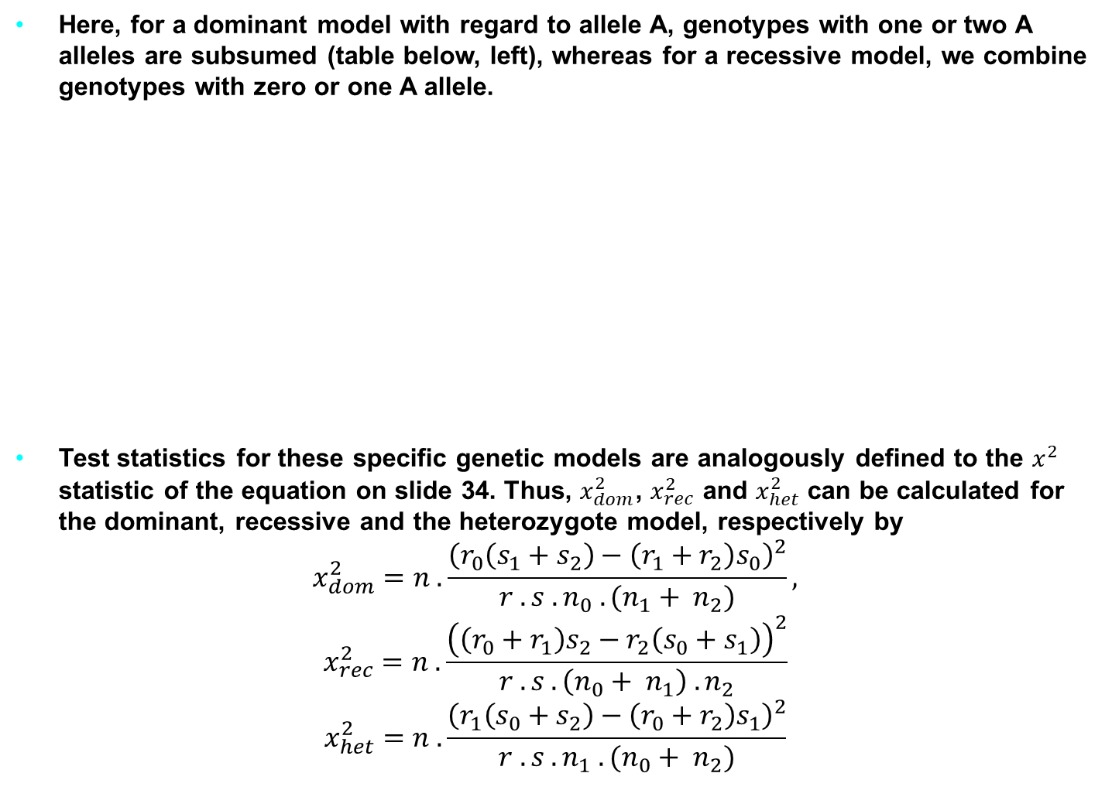
More Specific Alternative Hypotheses based on different genetic model
Here, for a dominant model with regard to allele A, genotypes with one or two A alleles are subsumed (table below, left), whereas for a recessive model, we combine genotypes with zero or one A allele.
Test statistics for these specific genetic models are analogously defined to the $x^{2}$ statistic of the equation on slide 34. Thus, $x_{dom}^{2}$, $x_{rec}^{2}$ and $x_{het}^{2}$ can be calculated for the dominant, recessive and the heterozygote model, respectively by
$$x_{dom}^{2}=n . \frac{{\left(r_{0}\left(s_{1}+s_{2}\right)−\left(r_{1}+r_{2}\right)s_{0}\right)}^{2}}{r . s . n_{0} . (n_{1}+ n_{2})},$$
$$x_{rec}^{2}=n . \frac{{\left(\left(r_{0}+r_{1}\right)s_{2}−r_{2}\left(s_{0}+s_{1}\right)\right)}^{2}}{r . s . \left(n_{0}+ n_{1}\right) . n_{2}}$$
$$x_{het}^{2}=n . \frac{{\left(r_{1}\left(s_{0}+s_{2}\right)−\left(r_{0}+r_{2}\right)s_{1}\right)}^{2}}{r . s . n_{1} . (n_{0}+ n_{2})}$$
 | Dominant |  | Heterozygote |  | Recessive
 | aA or AA | aa | aa or AA | aA | AA | aa or aA
Cases | r₁+r₂ | r₀ | r₀+r₂ | r₁ | r₂ | r₀+r₁
Control | s₁+s₂ | s₀ | s₀+s₂ | s₁ | s₂ | s₀+s₁
Total | n₁+n₂ | n₀ | n₀+n₂ | n₁ | n₂ | n₀+n₁
Tab. 5: Genotype frequencies in cases and controls for a dominant and a recessive genetic model with regard to allele A.
Notes:
The genetic material that carries the instructions that allow cells to make proteins
Composed of a sugar phosphate backbone from which four nitrogenous bases- adenine (A), guanine (G), cytosine (C), and thymine (T) protrude
Arranged in a double helix- two strands are held together by specific pairings between bases A – T pair and G – C pair

Slide 17
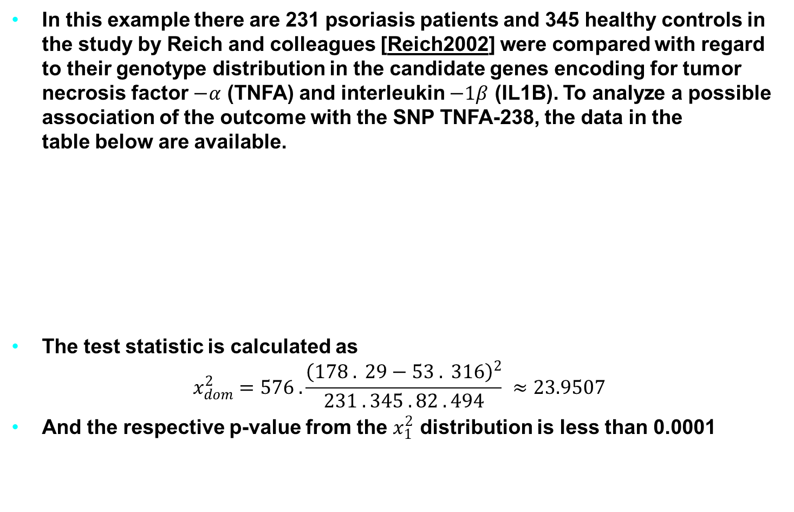
Example for Testing and Estimation
In this example there are 231 psoriasis patients and 345 healthy controls in the study by Reich and colleagues [Reich2002] were compared with regard to their genotype distribution in the candidate genes encoding for tumor necrosis factor $−α$ (TNFA) and interleukin $−1β$ (IL1B). To analyze a possible association of the outcome with the SNP TNFA-238, the data in the table below are available.
The test statistic is calculated as
$$x_{dom}^{2}=576 . \frac{{\left(178 . 29−53 . 316\right)}^{2}}{231 . 345 . 82 . 494} ≈23.9507$$
And the respective p-value from the $x_{1}^{2}$ distribution is less than 0.0001
 | AA or GA | GG | Total
Cases | 53 | 178 | 231
Controls | 29 | 316 | 345
Total | 82 | 494 | 576
Tab. 6: Observed genotype frequencies in patients and controls at TNFA-308.
Notes:
The genetic material that carries the instructions that allow cells to make proteins
Composed of a sugar phosphate backbone from which four nitrogenous bases- adenine (A), guanine (G), cytosine (C), and thymine (T) protrude
Arranged in a double helix- two strands are held together by specific pairings between bases A – T pair and G – C pair

Slide 18
Which variant to use for testing association?
The decision should be guided by the a priori hypothesis about the possible functioning of the mutation.
Focus on the analysis of genotype frequencies instead of allele frequencies.
Because of the statistics based on allele frequencies depend on the assumption of Hardy-Weinberg equilibrium (HWE), and they have been shown not to be robust against deviations from it.
In addition, it seems biologically more plausible to utilize genotypes, as this is how the genetic information in humans is naturally available.
In basing the analysis on genotype data, different approaches are possible depending on the presumed genetic model.
Notes:
The genetic material that carries the instructions that allow cells to make proteins
Composed of a sugar phosphate backbone from which four nitrogenous bases- adenine (A), guanine (G), cytosine (C), and thymine (T) protrude
Arranged in a double helix- two strands are held together by specific pairings between bases A – T pair and G – C pair

Slide 19
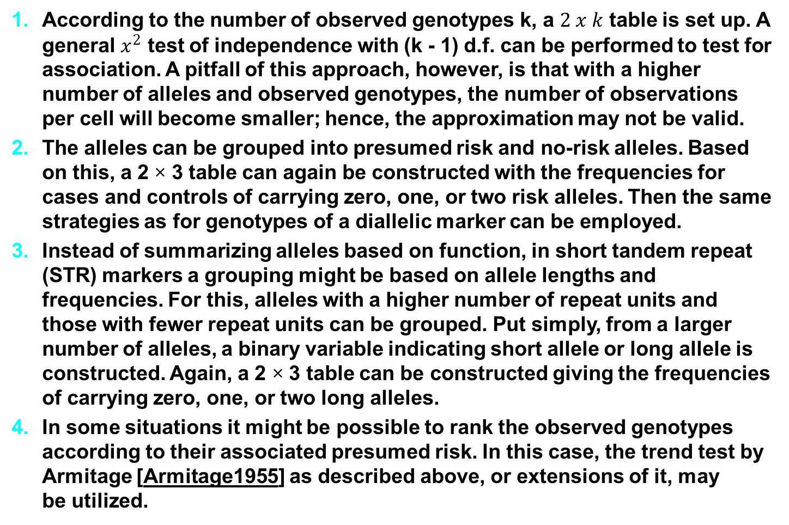
Variants for testing association with a multiallelic marker
According to the number of observed genotypes k, a $2 x k$ table is set up. A general $x^{2}$ test of independence with (k - 1) d.f. can be performed to test for association. A pitfall of this approach, however, is that with a higher number of alleles and observed genotypes, the number of observations per cell will become smaller; hence, the approximation may not be valid.
The alleles can be grouped into presumed risk and no-risk alleles. Based on this, a 2 × 3 table can again be constructed with the frequencies for cases and controls of carrying zero, one, or two risk alleles. Then the same strategies as for genotypes of a diallelic marker can be employed.
Instead of summarizing alleles based on function, in short tandem repeat (STR) markers a grouping might be based on allele lengths and frequencies. For this, alleles with a higher number of repeat units and those with fewer repeat units can be grouped. Put simply, from a larger number of alleles, a binary variable indicating short allele or long allele is constructed. Again, a 2 × 3 table can be constructed giving the frequencies of carrying zero, one, or two long alleles.
In some situations it might be possible to rank the observed genotypes according to their associated presumed risk. In this case, the trend test by Armitage [Armitage1955] as described above, or extensions of it, may be utilized.
Notes:
The genetic material that carries the instructions that allow cells to make proteins
Composed of a sugar phosphate backbone from which four nitrogenous bases- adenine (A), guanine (G), cytosine (C), and thymine (T) protrude
Arranged in a double helix- two strands are held together by specific pairings between bases A – T pair and G – C pair

Slide 20
Odds Ratio (OR)
OR can be used when a genotype at a given SNP has three levels: homozygous wildtype, heterozygous, and homozygous rare.
If the outcome is binary then the data can be represented by 2x3 contingency table as follows:
Here nij is the number of individuals in the corresponding cell for i = 1, 2 and j = 1, 2, 3.
For example, n11 is the number of individuals in our sample who have disease and express the aa genotype.
In this setting, a commonly used measure of association is the odds ratio (OR).
 |  | Genotype
 |  | aa | Aa | AA
Disease | + | n₁₁ | n₁₂ | n₁₃ | n_{1.}
 | - | n₂₁ | n₂₂ | n₂₃ | n_{2.}
 |  | n_{.1} | n_{.2} | n_{.3} | n
2 × 3 contingency table for genotype - disease association
Notes:
The genetic material that carries the instructions that allow cells to make proteins
Composed of a sugar phosphate backbone from which four nitrogenous bases- adenine (A), guanine (G), cytosine (C), and thymine (T) protrude
Arranged in a double helix- two strands are held together by specific pairings between bases A – T pair and G – C pair

Slide 21
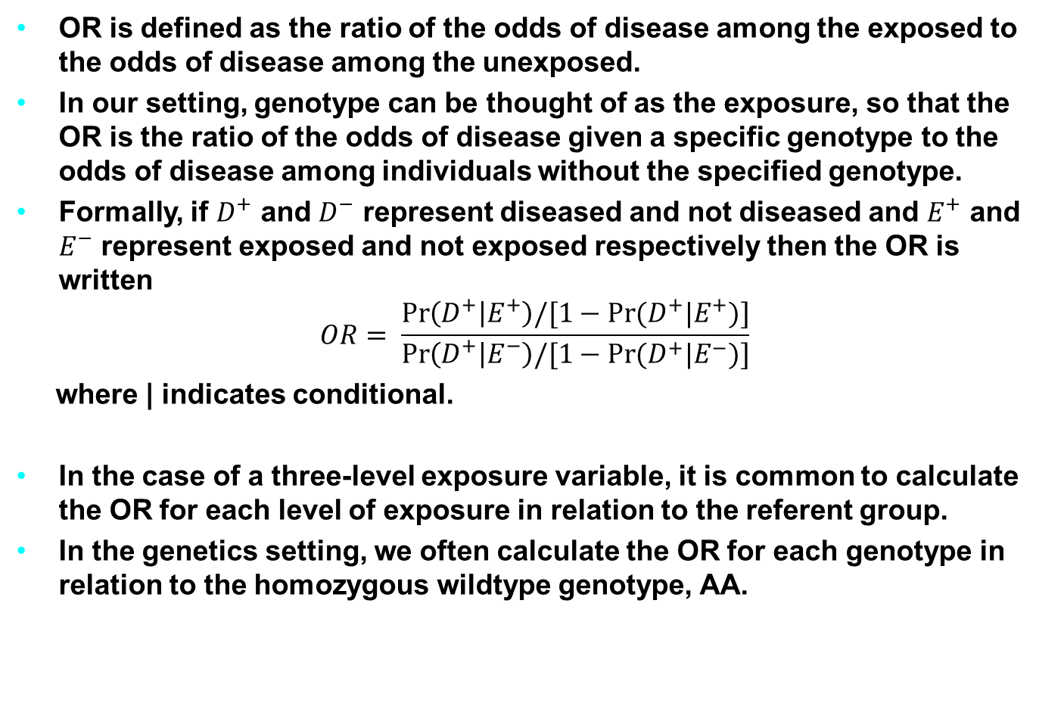
Odds Ratio (OR)
OR is defined as the ratio of the odds of disease among the exposed to the odds of disease among the unexposed.
In our setting, genotype can be thought of as the exposure, so that the OR is the ratio of the odds of disease given a specific genotype to the odds of disease among individuals without the specified genotype.
Formally, if $D^{+}$ and $D^{−}$ represent diseased and not diseased and $E^{+}$ and $E^{−}$ represent exposed and not exposed respectively then the OR is written
$$OR= \frac{\operatorname{Pr}\left(D^{+} | E^{+}\right)/[1−\operatorname{Pr}{(D^{+}|E^{+})}]}{\operatorname{Pr}\left(D^{+} | E^{−}\right)/[1−\operatorname{Pr}{(D^{+}|E^{−})}]}$$
where | indicates conditional.
In the case of a three-level exposure variable, it is common to calculate the OR for each level of exposure in relation to the referent group.
In the genetics setting, we often calculate the OR for each genotype in relation to the homozygous wildtype genotype, AA.
Notes:
The genetic material that carries the instructions that allow cells to make proteins
Composed of a sugar phosphate backbone from which four nitrogenous bases- adenine (A), guanine (G), cytosine (C), and thymine (T) protrude
Arranged in a double helix- two strands are held together by specific pairings between bases A – T pair and G – C pair

Slide 22
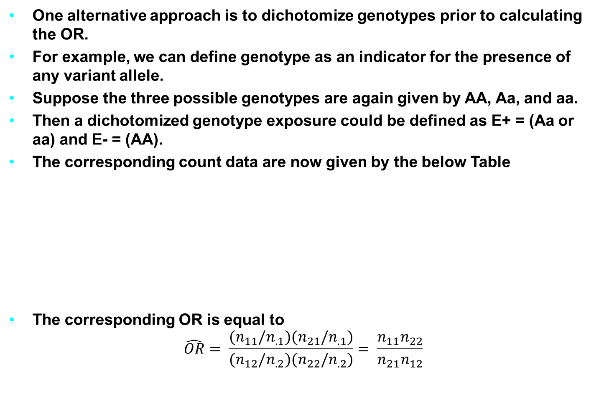
Odds Ratio (OR)
One alternative approach is to dichotomize genotypes prior to calculating the OR.
For example, we can define genotype as an indicator for the presence of any variant allele.
Suppose the three possible genotypes are again given by AA, Aa, and aa.
Then a dichotomized genotype exposure could be defined as E+ = (Aa or aa) and E- = (AA).
The corresponding count data are now given by the below Table
The corresponding OR is equal to
$$\hat{OR}= \frac{(n_{11}/n_{.1})(n_{21}/n_{.1})}{(n_{12}/n_{.2})(n_{22}/n_{.2})}= \frac{n_{11}n_{22}}{n_{21}n_{12}}$$
 |  | Genotype |  | Total
 |  | (Aa or aa) | AA
Disease | + | n₁₁ | n₁₂ | n_{1.}
 | - | n₂₁ | n₂₂ | n_{2.}
 | Total | n_{.1} | n_{.2} | n
Notes:
The genetic material that carries the instructions that allow cells to make proteins
Composed of a sugar phosphate backbone from which four nitrogenous bases- adenine (A), guanine (G), cytosine (C), and thymine (T) protrude
Arranged in a double helix- two strands are held together by specific pairings between bases A – T pair and G – C pair

Slide 23

Odds Ratio (OR)
We define ${OR}_{aa,AA}$ as the odds of disease for individuals with the homozygous rare genotype, aa, compared with those with the homozygous wildtype genotype AA.
$$OR= \frac{(n_{11}/n_{.1})(n_{21}/n_{.1})}{(n_{13}/n_{.3})(n_{23}/n_{.3})}= \frac{n_{11}n_{23}}{n_{21}n_{13}}$$
Notes:
The genetic material that carries the instructions that allow cells to make proteins
Composed of a sugar phosphate backbone from which four nitrogenous bases- adenine (A), guanine (G), cytosine (C), and thymine (T) protrude
Arranged in a double helix- two strands are held together by specific pairings between bases A – T pair and G – C pair

Slide 24
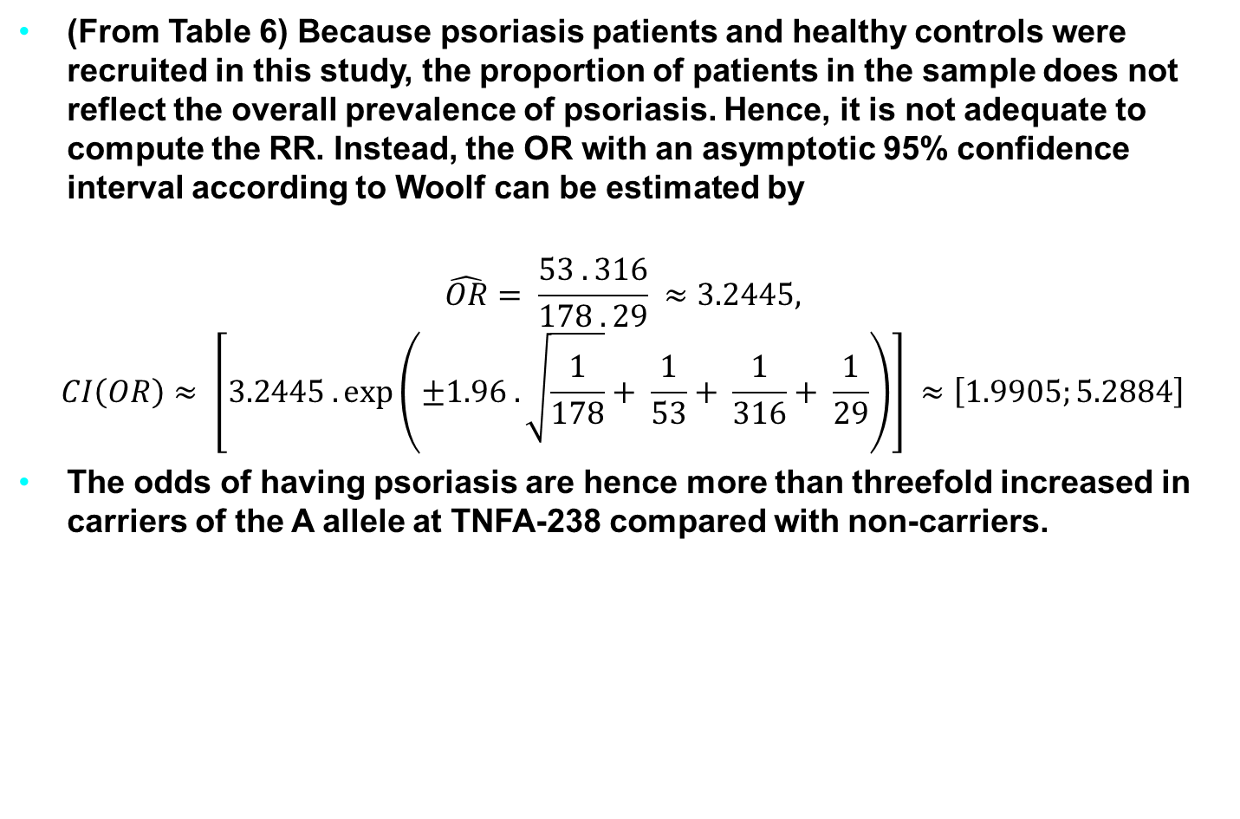
Example for Testing and Estimation
(From Table 6) Because psoriasis patients and healthy controls were recruited in this study, the proportion of patients in the sample does not reflect the overall prevalence of psoriasis. Hence, it is not adequate to compute the RR. Instead, the OR with an asymptotic 95% confidence interval according to Woolf can be estimated by
$$\hat{OR}= \frac{53 . 316}{178 . 29} ≈3.2445,$$
$$CI\left(OR\right)≈ \left[3.2445 .\exp\left(±1.96 . \sqrt{\frac{1}{178}}+ \frac{1}{53}+ \frac{1}{316}+ \frac{1}{29}\right)\right] ≈\left[1.9905;5.2884\right]$$
The odds of having psoriasis are hence more than threefold increased in carriers of the A allele at TNFA-238 compared with non-carriers.
Notes:
The genetic material that carries the instructions that allow cells to make proteins
Composed of a sugar phosphate backbone from which four nitrogenous bases- adenine (A), guanine (G), cytosine (C), and thymine (T) protrude
Arranged in a double helix- two strands are held together by specific pairings between bases A – T pair and G – C pair

Slide 25
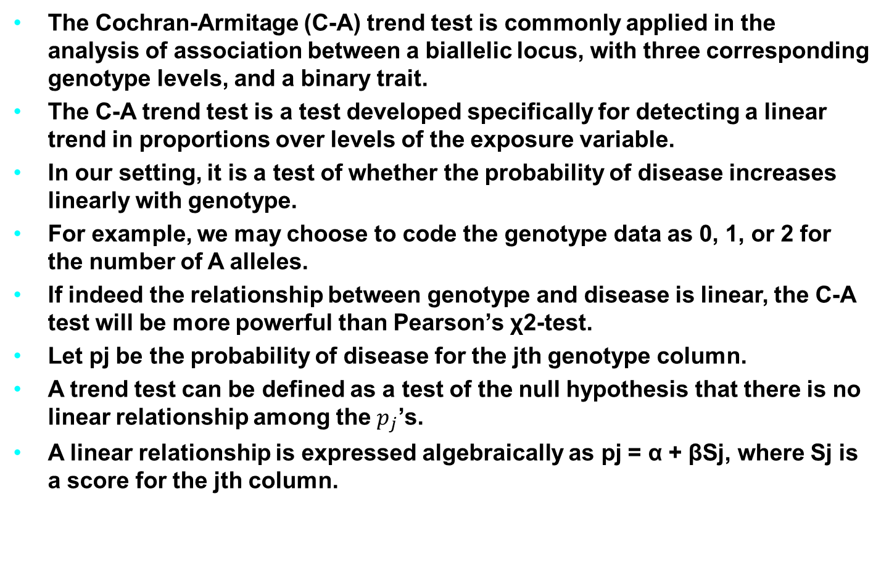
Cochran-Armitage Trend Test (CATT)
The Cochran-Armitage (C-A) trend test is commonly applied in the analysis of association between a biallelic locus, with three corresponding genotype levels, and a binary trait.
The C-A trend test is a test developed specifically for detecting a linear trend in proportions over levels of the exposure variable.
In our setting, it is a test of whether the probability of disease increases linearly with genotype.
For example, we may choose to code the genotype data as 0, 1, or 2 for the number of A alleles.
If indeed the relationship between genotype and disease is linear, the C-A test will be more powerful than Pearson’s χ2-test.
Let pj be the probability of disease for the jth genotype column.
A trend test can be defined as a test of the null hypothesis that there is no linear relationship among the $p_{j}$’s.
A linear relationship is expressed algebraically as pj = α + βSj, where Sj is a score for the jth column.
Notes:
The genetic material that carries the instructions that allow cells to make proteins
Composed of a sugar phosphate backbone from which four nitrogenous bases- adenine (A), guanine (G), cytosine (C), and thymine (T) protrude
Arranged in a double helix- two strands are held together by specific pairings between bases A – T pair and G – C pair

Slide 26
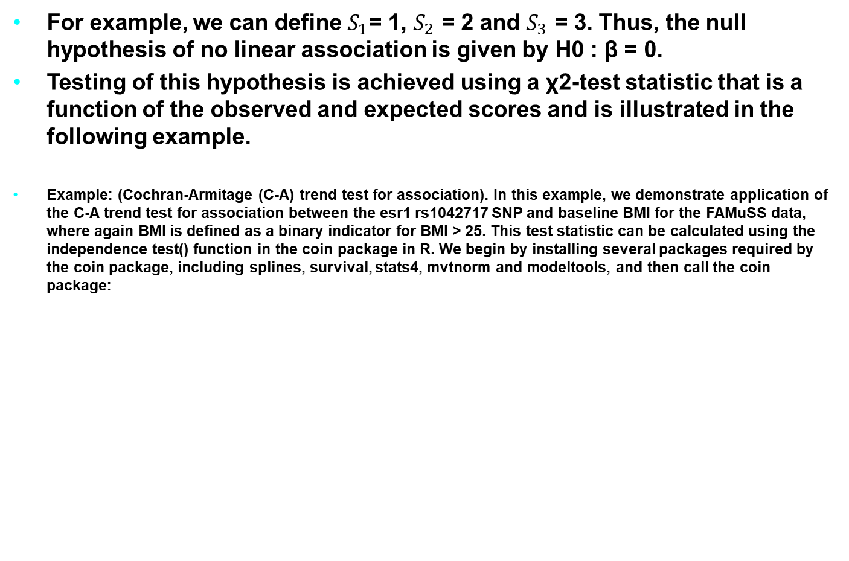
Cochran-Armitage Trend Test (CATT)
For example, we can define $S_{1}$= 1, $S_{2}$ = 2 and $S_{3}$ = 3. Thus, the null hypothesis of no linear association is given by H0 : β = 0.
Testing of this hypothesis is achieved using a χ2-test statistic that is a function of the observed and expected scores and is illustrated in the following example.
Example: (Cochran-Armitage (C-A) trend test for association). In this example, we demonstrate application of the C-A trend test for association between the esr1 rs1042717 SNP and baseline BMI for the FAMuSS data, where again BMI is defined as a binary indicator for BMI > 25. This test statistic can be calculated using the independence test() function in the coin package in R. We begin by installing several packages required by the coin package, including splines, survival, stats4, mvtnorm and modeltools, and then call the coin package:
Notes:
The genetic material that carries the instructions that allow cells to make proteins
Composed of a sugar phosphate backbone from which four nitrogenous bases- adenine (A), guanine (G), cytosine (C), and thymine (T) protrude
Arranged in a double helix- two strands are held together by specific pairings between bases A – T pair and G – C pair

Slide 27
Cochran-Armitage Trend Test (CATT)
install.packages("coin") library(coin)
We then define our genotype and trait variables without needing to exclude observations with missing genotypes: attach(fms) Geno <- esr1_rs1042717 Trait <- as.numeric(pre.BMI>25)
The independence test() function, with the option testat="quad" specified, can then be applied to conduct the C-A trend test. Here we use the ordered() function to specify that the genotypes are ordered. The scores option allows us to specify the relationship between different levels of our genotype:
GenoOrd <- ordered(Geno) independence_test(Trait~GenoOrd,teststat="quad", scores=list(GenoOrd=c(0,1,2))) #Asymptotic General Independence Test #data: Trait by Geno.or (AA < GA < GG) chi-squared = 4.4921, df = 1, p-value = 0.03405
Notes:
The genetic material that carries the instructions that allow cells to make proteins
Composed of a sugar phosphate backbone from which four nitrogenous bases- adenine (A), guanine (G), cytosine (C), and thymine (T) protrude
Arranged in a double helix- two strands are held together by specific pairings between bases A – T pair and G – C pair

Slide 28
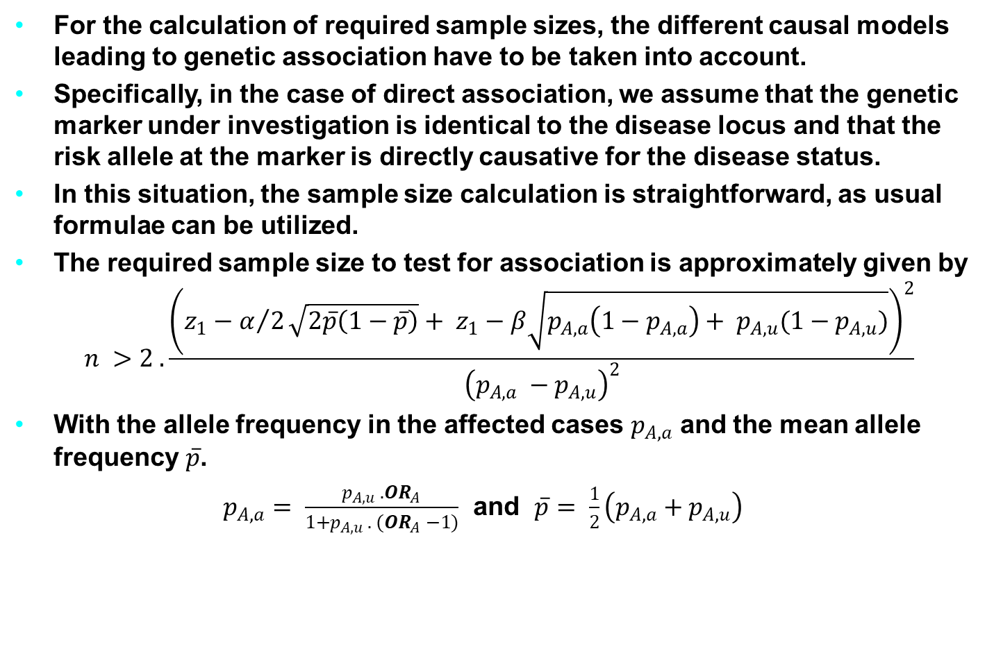
Sample Size Calculation
For the calculation of required sample sizes, the different causal models leading to genetic association have to be taken into account.
Specifically, in the case of direct association, we assume that the genetic marker under investigation is identical to the disease locus and that the risk allele at the marker is directly causative for the disease status.
In this situation, the sample size calculation is straightforward, as usual formulae can be utilized.
The required sample size to test for association is approximately given by
$$n >2 . \frac{{\left(z_{1}−α/2\sqrt{2\overline{p}\left(1−\overline{p}\right)}+ z_{1}−β\sqrt{p_{A,a}\left(1−p_{A,a}\right)+ p_{A,u}(1−p_{A,u})}\right)}^{2}}{{\left(p_{A,a} −p_{A,u}\right)}^{2}}$$
With the allele frequency in the affected cases $p_{A,a}$ and the mean allele frequency $\overline{p}$.
$p_{A,a}= \frac{p_{A,u} . {OR}_{A}}{1+p_{A,u} . ({OR}_{A} −1)}$ and $\overline{p}= \frac{1}{2}\left(p_{A,a}+p_{A,u}\right)$
Notes:
The genetic material that carries the instructions that allow cells to make proteins
Composed of a sugar phosphate backbone from which four nitrogenous bases- adenine (A), guanine (G), cytosine (C), and thymine (T) protrude
Arranged in a double helix- two strands are held together by specific pairings between bases A – T pair and G – C pair

Slide 29
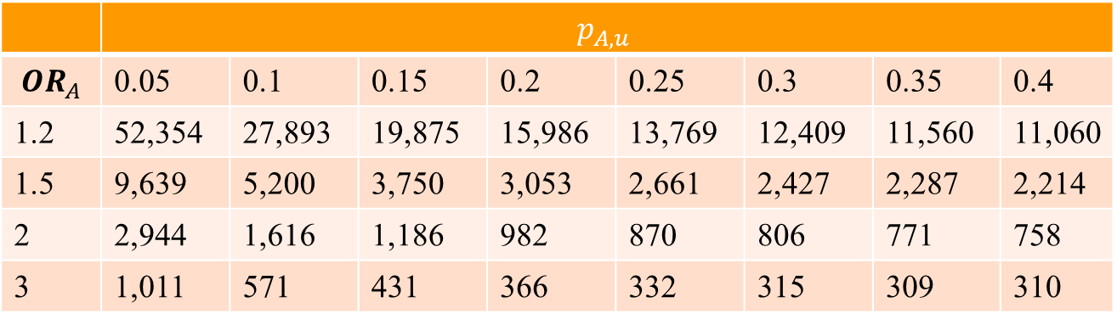
Example of Resulting Sample Sizes for Different Scenarios
Examples for resulting sample sizes for different scenarios are given in the following table:
 | $$p_{A,u}$$
$${OR}_{A}$$ | 0.05 | 0.1 | 0.15 | 0.2 | 0.25 | 0.3 | 0.35 | 0.4
1.2 | 52,354 | 27,893 | 19,875 | 15,986 | 13,769 | 12,409 | 11,560 | 11,060
1.5 | 9,639 | 5,200 | 3,750 | 3,053 | 2,661 | 2,427 | 2,287 | 2,214
2 | 2,944 | 1,616 | 1,186 | 982 | 870 | 806 | 771 | 758
3 | 1,011 | 571 | 431 | 366 | 332 | 315 | 309 | 310
Tab. 7: Required sample sizes to detect an odds ratio ORA for the allele A with an allele frequency pA,u in unaffected controls at a significance level alpha = 0.0001 and a power of 80%.
Notes:
The genetic material that carries the instructions that allow cells to make proteins
Composed of a sugar phosphate backbone from which four nitrogenous bases- adenine (A), guanine (G), cytosine (C), and thymine (T) protrude
Arranged in a double helix- two strands are held together by specific pairings between bases A – T pair and G – C pair

Slide 30
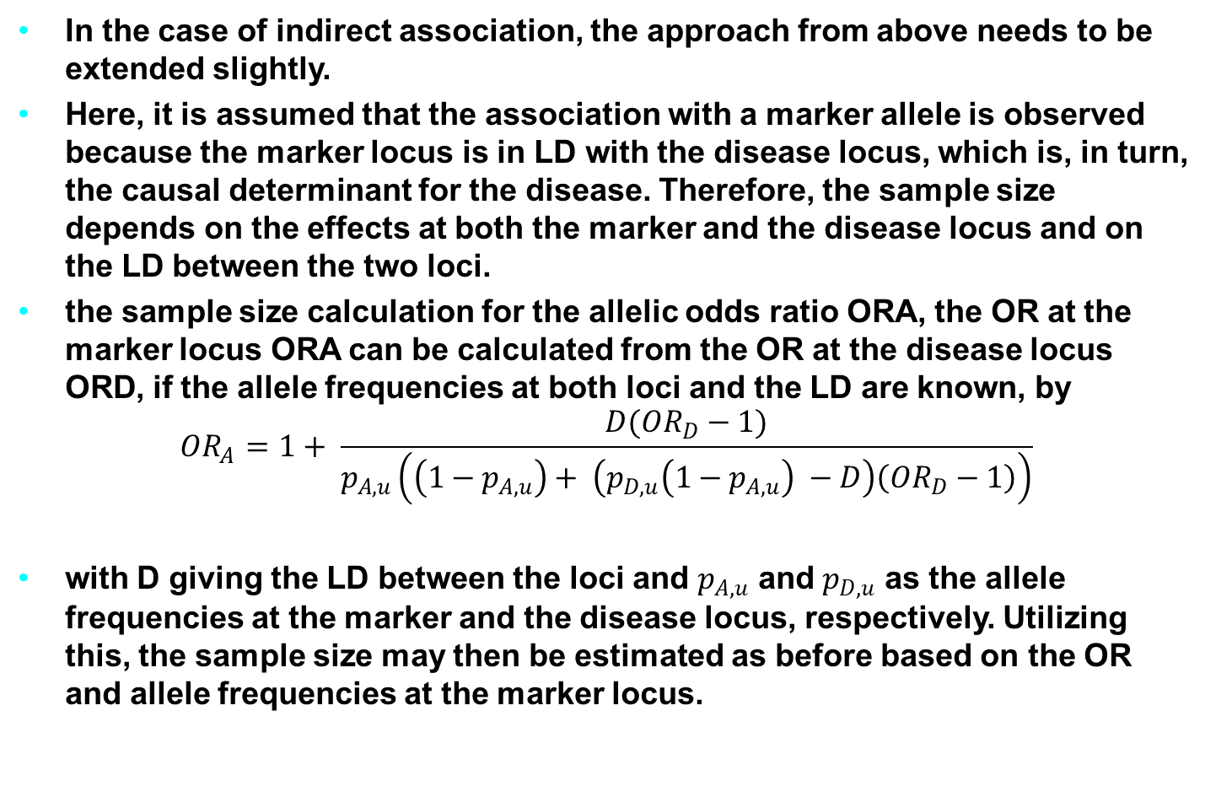
Sample Size for the Case of Indirect Association
In the case of indirect association, the approach from above needs to be extended slightly.
Here, it is assumed that the association with a marker allele is observed because the marker locus is in LD with the disease locus, which is, in turn, the causal determinant for the disease. Therefore, the sample size depends on the effects at both the marker and the disease locus and on the LD between the two loci.
the sample size calculation for the allelic odds ratio ORA, the OR at the marker locus ORA can be calculated from the OR at the disease locus ORD, if the allele frequencies at both loci and the LD are known, by
$${OR}_{A}=1+ \frac{D({OR}_{D}−1)}{p_{A,u}\left(\left(1−p_{A,u}\right)+ \left(p_{D,u}\left(1−p_{A,u}\right) −D\right)\left({OR}_{D}−1\right)\right)}$$
with D giving the LD between the loci and $p_{A,u}$ and $p_{D,u}$ as the allele frequencies at the marker and the disease locus, respectively. Utilizing this, the sample size may then be estimated as before based on the OR and allele frequencies at the marker locus.
Notes:
The genetic material that carries the instructions that allow cells to make proteins
Composed of a sugar phosphate backbone from which four nitrogenous bases- adenine (A), guanine (G), cytosine (C), and thymine (T) protrude
Arranged in a double helix- two strands are held together by specific pairings between bases A – T pair and G – C pair

Slide 31
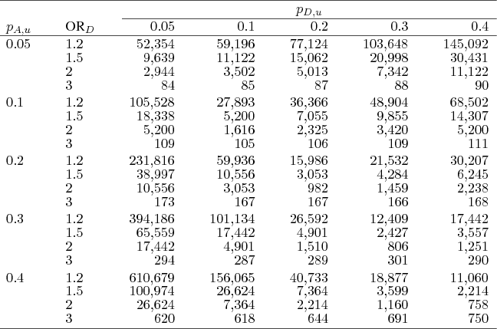

Resulting Sample Sizes for Indirect Association
The table below shows the required sample sizes to detect an odds ratio ${OR}_{D}$ for the disease allele D with an allele frequency $p_{A,u}$ and disease allele frequency $p_{D,u}$ in unaffected controls at $D= D_{max}$, a significance level $α=0.0001$, and a power of 80%
Notes:
The genetic material that carries the instructions that allow cells to make proteins
Composed of a sugar phosphate backbone from which four nitrogenous bases- adenine (A), guanine (G), cytosine (C), and thymine (T) protrude
Arranged in a double helix- two strands are held together by specific pairings between bases A – T pair and G – C pair

Slide 32
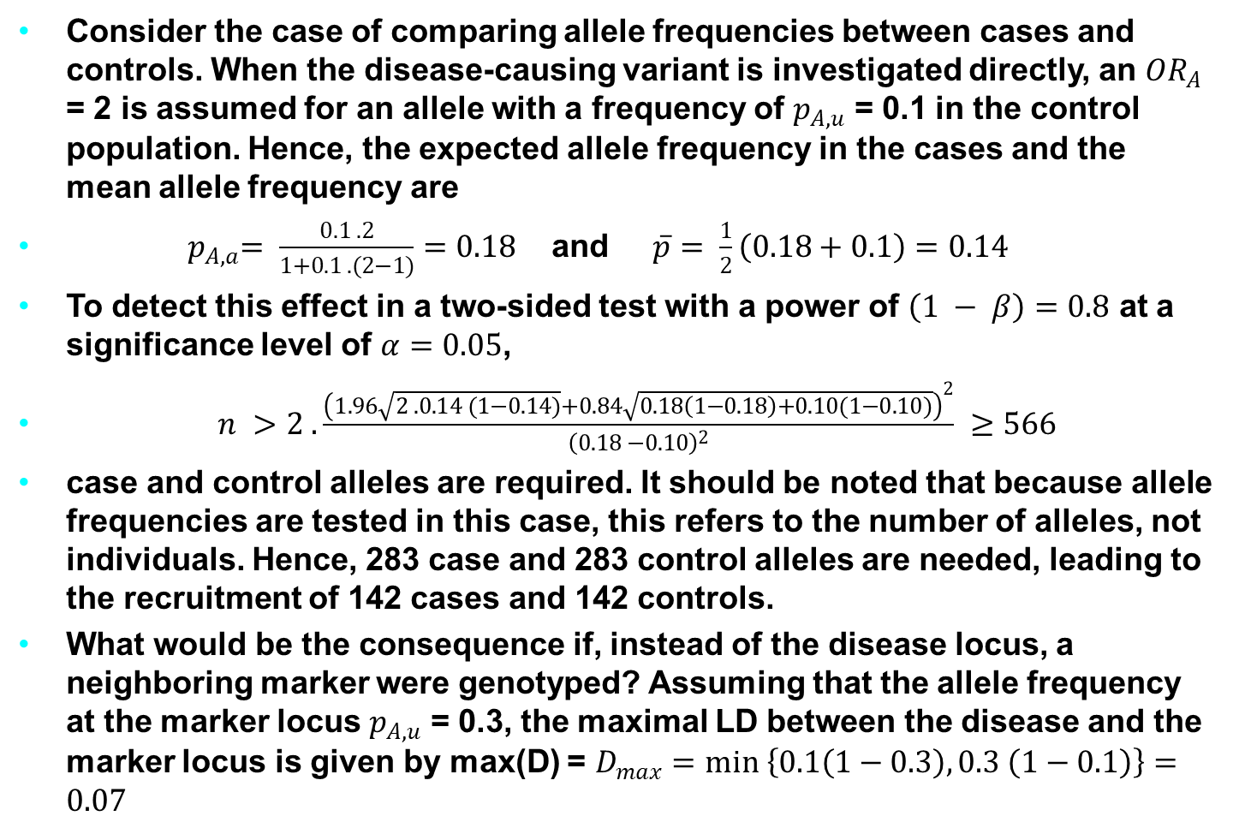
Example of Sample Size Calculation
Consider the case of comparing allele frequencies between cases and controls. When the disease-causing variant is investigated directly, an ${OR}_{A}$ = 2 is assumed for an allele with a frequency of $p_{A,u}$ = 0.1 in the control population. Hence, the expected allele frequency in the cases and the mean allele frequency are
${ p}_{A,a}= \frac{0.1 . 2}{1+0.1 . (2−1)}=0.18$ and $\overline{p}= \frac{1}{2}\left(0.18+0.1\right)=0.14$
To detect this effect in a two-sided test with a power of $\left(1 − β\right)=0.8$ at a significance level of $α=0.05$,
$n >2 . \frac{{\left(1.96\sqrt{2 . 0.14 (1−0.14)}+0.84\sqrt{0.18\left(1−0.18\right)+0.10(1−0.10)}\right)}^{2}}{{\left(0.18 −0.10\right)}^{2}} ≥566$
case and control alleles are required. It should be noted that because allele frequencies are tested in this case, this refers to the number of alleles, not individuals. Hence, 283 case and 283 control alleles are needed, leading to the recruitment of 142 cases and 142 controls.
What would be the consequence if, instead of the disease locus, a neighboring marker were genotyped? Assuming that the allele frequency at the marker locus $p_{A,u}$ = 0.3, the maximal LD between the disease and the marker locus is given by max(D) = $D_{max}=min \left\{0.1\left(1−0.3\right), 0.3 \left(1−0.1\right)\right\}=0.07$
Notes:
The genetic material that carries the instructions that allow cells to make proteins
Composed of a sugar phosphate backbone from which four nitrogenous bases- adenine (A), guanine (G), cytosine (C), and thymine (T) protrude
Arranged in a double helix- two strands are held together by specific pairings between bases A – T pair and G – C pair

Slide 33

Example of Sample Size Calculation
In the situation that the LD is maximal, the OR at the marker locus would therefore be reduced to
$${OR}_{A}=1+ \frac{0.07(2−1)}{0.3\left(\left(1−0.3\right)+ \left(0.1\left(1−0.3\right) −2\right)\left(2−1\right)\right)}=1.33$$
Fitting ${OR}_{A}$ and $p_{A,u}$ into the sample size equation demonstrates the effect: instead of 566 case and control alleles, 1,720 are required in this setting of indirect association, corresponding to 430 cases and 430 controls.
Notes:
The genetic material that carries the instructions that allow cells to make proteins
Composed of a sugar phosphate backbone from which four nitrogenous bases- adenine (A), guanine (G), cytosine (C), and thymine (T) protrude
Arranged in a double helix- two strands are held together by specific pairings between bases A – T pair and G – C pair

Slide 34
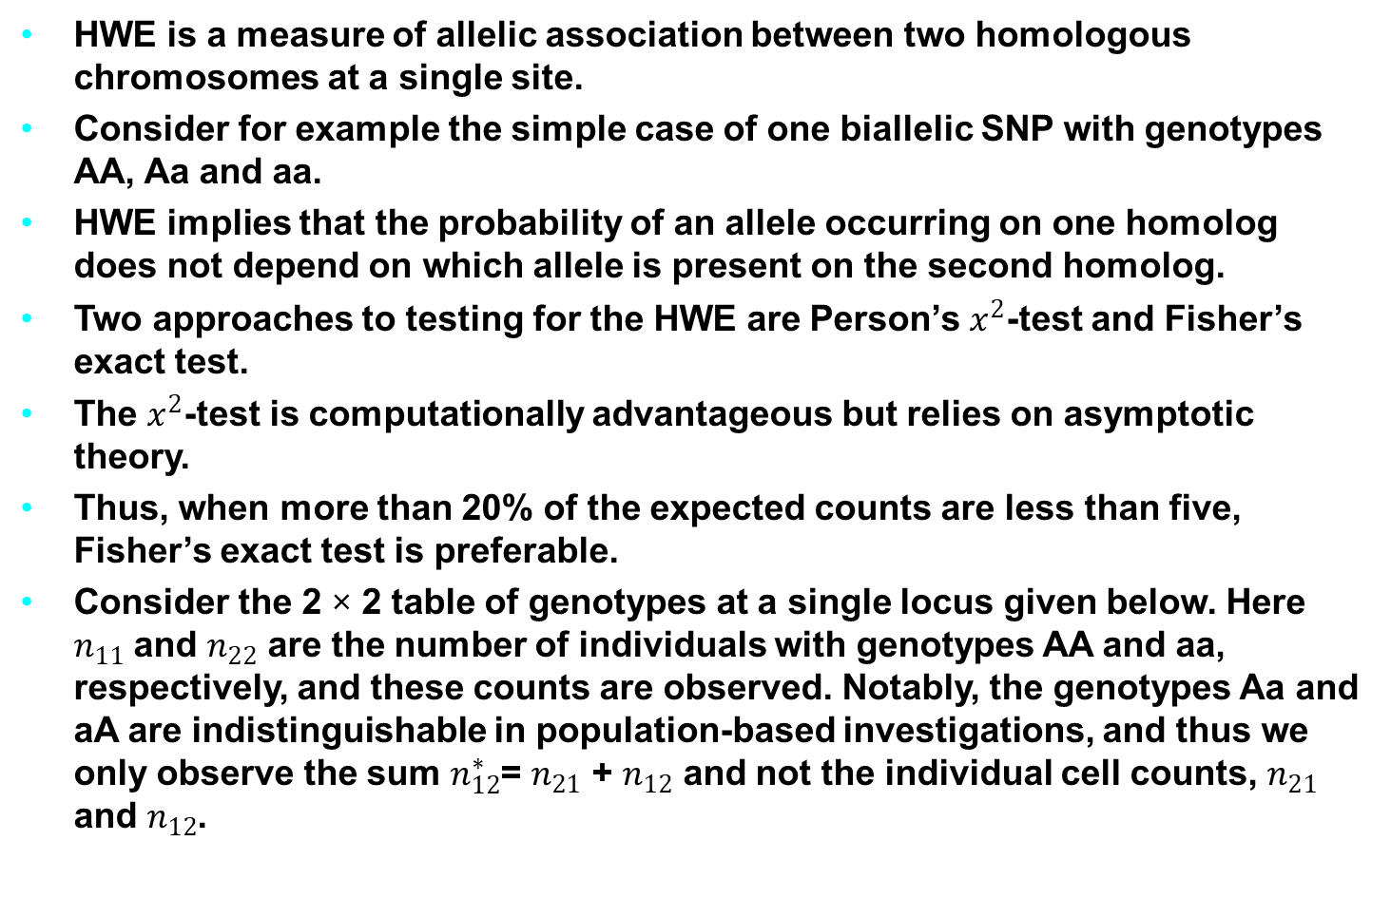
Hardy-Weinberg Equilibrium (HWE)
HWE is a measure of allelic association between two homologous chromosomes at a single site.
Consider for example the simple case of one biallelic SNP with genotypes AA, Aa and aa.
HWE implies that the probability of an allele occurring on one homolog does not depend on which allele is present on the second homolog.
Two approaches to testing for the HWE are Person’s $x^{2}$-test and Fisher’s exact test.
The $x^{2}$-test is computationally advantageous but relies on asymptotic theory.
Thus, when more than 20% of the expected counts are less than five, Fisher’s exact test is preferable.
Consider the 2 × 2 table of genotypes at a single locus given below. Here $n_{11}$ and $n_{22}$ are the number of individuals with genotypes AA and aa, respectively, and these counts are observed. Notably, the genotypes Aa and aA are indistinguishable in population-based investigations, and thus we only observe the sum $n_{12}^{∗}$= $n_{21}$ + $n_{12}$ and not the individual cell counts, $n_{21}$ and $n_{12}$.
Notes:
The genetic material that carries the instructions that allow cells to make proteins
Composed of a sugar phosphate backbone from which four nitrogenous bases- adenine (A), guanine (G), cytosine (C), and thymine (T) protrude
Arranged in a double helix- two strands are held together by specific pairings between bases A – T pair and G – C pair

Slide 35
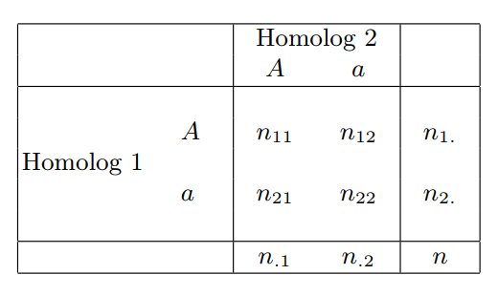

Hardy-Weinberg Equilibrium (HWE)
The expected counts corresponding to these three observed counts, $n_{11}$, $n_{12}^{∗}$, $n_{22}$, are given respectively by $E_{11}$ =$Np_{A}^{2}$, $E_{12}$ = $2Np_{A}$(1 - $p_{A}$) and $E_{22}$ = N(1- $p_{A}$)2, where $p_{A}$ is the probability of A and is estimated based on the observed allele count. That is, we let $p_{A}$ = (2 $n_{11}$ + $n_{12}^{∗}$) = (2N). The χ2-test statistic is then constructed as following:
$$x^{2}=\sum_{i,j ∈C}{\frac{{(O_{ij} − E_{ij})}^{2}}{E_{ij}}} \sim x_{1}^{2}$$
Tab. 9 Genotype counts for two homologous chromosomes
Notes:
The genetic material that carries the instructions that allow cells to make proteins
Composed of a sugar phosphate backbone from which four nitrogenous bases- adenine (A), guanine (G), cytosine (C), and thymine (T) protrude
Arranged in a double helix- two strands are held together by specific pairings between bases A – T pair and G – C pair

Slide 36
Hardy-Weinberg Equilibrium (HWE)
Example: (Testing for HWE using Pearson’s χ2-test). Suppose we are interested in testing for HWE for the SNP labeled AKT1.C0756A in the HGDP data. To do this, we first need to calculate the observed and expected genotype counts. This can be done as follows:
attach(hgdp)
Akt1Snp1 <- AKT1.C0756A
ObsCount <- table(Akt1Snp1)
Nobs <- sum(ObsCount)
ObsCount
FreqC <- (2 * ObsCount[3] + ObsCount[2])/(2*Nobs)
ExpCount <- c(Nobs*(1-FreqC)^2, 2*Nobs*FreqC*(1-FreqC),Nobs*FreqC^2)
ExpCount
In this example, vectors of observed and expected counts are for the genotypes AA, CA and CC, respectively. The χ2-statistic is calculated using the formula of previous Equation and the following R code:
ChiSqStat <- sum((ObsCount - ExpCount)^2/ExpCount)
ChiSqStat
Notes:
The genetic material that carries the instructions that allow cells to make proteins
Composed of a sugar phosphate backbone from which four nitrogenous bases- adenine (A), guanine (G), cytosine (C), and thymine (T) protrude
Arranged in a double helix- two strands are held together by specific pairings between bases A – T pair and G – C pair

Slide 37
Hardy-Weinberg Equilibrium (HWE)
Alternatively, the HWE.chisq() function in the genetics package can be used to calculate this statistic. In this case, we first use the genotype() function to create a genotype object as follows:
library(genetics)
example.data <- c("D/D","D/I","D/D","I/I","D/D","D/D","D/D","D/D","I/I","")
g1 <- genotype(Example.data)
g1
HWE.chisq(g1)
Pearson's Chi-squared test with simulated p-value (based on 10000 replicates) data: tab X-squared = 4.7056, df = NA, p-value = 0.0377
We would reject the null hypothesis of HWE at this SNP locus and conclude instead that the alleles on the two homologous chromosomes are associated with one another.
Notes:
The genetic material that carries the instructions that allow cells to make proteins
Composed of a sugar phosphate backbone from which four nitrogenous bases- adenine (A), guanine (G), cytosine (C), and thymine (T) protrude
Arranged in a double helix- two strands are held together by specific pairings between bases A – T pair and G – C pair

Slide 38
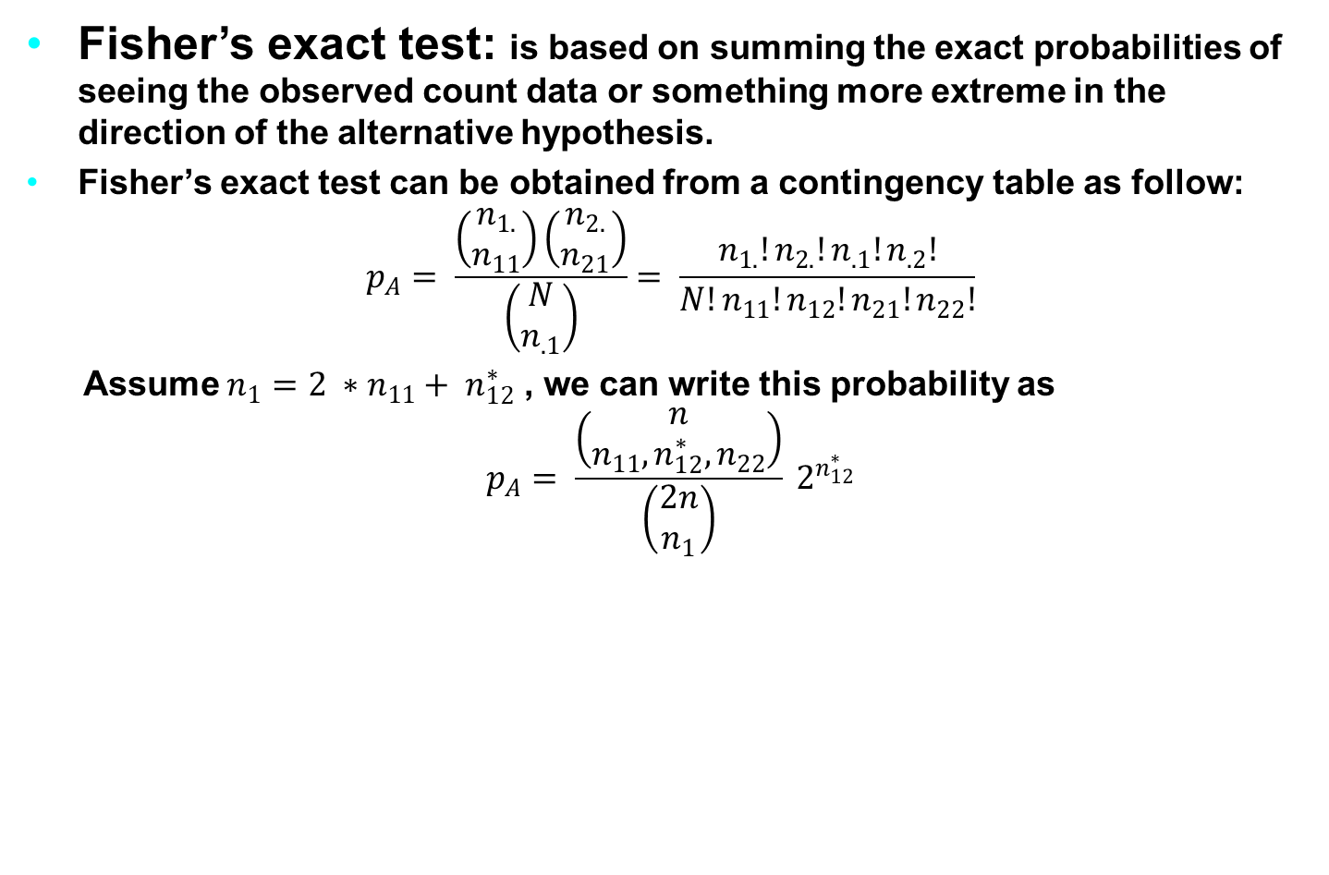
Hardy-Weinberg Equilibrium (HWE)
Fisher’s exact test: is based on summing the exact probabilities of seeing the observed count data or something more extreme in the direction of the alternative hypothesis.
Fisher’s exact test can be obtained from a contingency table as follow:
$$p_{A}= \frac{\left(\begin{matrix}n_{1.} \\ n_{11}\end{matrix}\right)\left(\begin{matrix}n_{2.} \\ n_{21}\end{matrix}\right)}{\left(\begin{matrix}N \\ n_{.1}\end{matrix}\right)}= \frac{n_{1.}!n_{2.}!n_{.1}!n_{.2}!}{N!n_{11}!n_{12}!n_{21}!n_{22}!}$$
Assume $n_{1}=2 ∗n_{11}+ n_{12}^{∗}$ , we can write this probability as
$$p_{A}= \frac{\left(\begin{matrix}n \\ n_{11},n_{12}^{∗},n_{22}\end{matrix}\right)}{\left(\begin{matrix}2n \\ n_{1}\end{matrix}\right)} 2^{n_{12}^{∗}}$$
Notes:
The genetic material that carries the instructions that allow cells to make proteins
Composed of a sugar phosphate backbone from which four nitrogenous bases- adenine (A), guanine (G), cytosine (C), and thymine (T) protrude
Arranged in a double helix- two strands are held together by specific pairings between bases A – T pair and G – C pair

Slide 39
Hardy-Weinberg equilibrium (HWE)
Example: (Testing for HWE using Fisher’s exact test). Now suppose we are interested in testing for a departure from HWE for the same SNP of previous Example but only within the Maya population. This subgroup consists of n = 25 individuals, and the observed and expected genotype counts are calculated as follows:
attach(hgdp)
Akt1Snp1Maya <- AKT1.C0756A[Population=="Maya"]
ObsCount <- table(Akt1Snp1Maya)
ObsCount
Nobs <- sum(ObsCount)
FreqC <- (2 * ObsCount[3] + ObsCount[2])/(2*Nobs)
ExpCount <- c(Nobs*(1-FreqC)^2, 2*Nobs*FreqC*(1-FreqC),Nobs*FreqC^2)
ExpCount
Since the expected count for the first cell is less than 5, using Fisher’s exact test to test for HWE is most appropriate. An exact probability of seeing the observed counts, as described in the previous equation, is given by FisherP1 in the following code example:
Notes:
The genetic material that carries the instructions that allow cells to make proteins
Composed of a sugar phosphate backbone from which four nitrogenous bases- adenine (A), guanine (G), cytosine (C), and thymine (T) protrude
Arranged in a double helix- two strands are held together by specific pairings between bases A – T pair and G – C pair

Slide 40
Hardy-Weinberg equilibrium (HWE)
Example: (Testing for HWE using Fisher’s exact test). Now suppose we are interested in testing for a departure from HWE for the same SNP of previous Example but only within the Maya population. This subgroup consists of n = 25 individuals, and the observed and expected genotype counts are calculated as follows:
# Hardy-Weinberg Equilibrium (HWE)
Akt1Snp1 <- hgdp$AKT1.C0756A
ObsCount <- table(Akt1Snp1)
ObsCount
Nobs <- sum(ObsCount)
FreqC <- (2 * ObsCount[3] + ObsCount[2])/(2*Nobs)
ExpCount <- c(Nobs*(1-FreqC)^2, 2*Nobs*FreqC*(1-FreqC),Nobs*FreqC^2)
ExpCount
ChiSqStat <- sum((ObsCount - ExpCount)^2/ExpCount)
ChiSqStat
Notes:
The genetic material that carries the instructions that allow cells to make proteins
Composed of a sugar phosphate backbone from which four nitrogenous bases- adenine (A), guanine (G), cytosine (C), and thymine (T) protrude
Arranged in a double helix- two strands are held together by specific pairings between bases A – T pair and G – C pair

Slide 41
Hardy-Weinberg Equilibrium (HWE)
The function HWE.exact() from the genetics package can also be used to calculate this exact p-value, as illustrated below:
library(genetics)
Example.data <- c("D/D","D/I","D/D","I/I","D/D","D/D","D/D","D/D","I/I","")
g1 <- genotype(Example.data)
g1
HWE.exact(g1)
Exact Test for Hardy-Weinberg Equilibrium data: g1 N11 = 6, N12 = 1, N22 = 2, N1 = 13, N2 = 5, p-value = 0.05882
Based on this output, we see that the exact p-value is 0.05882 and we are unable to reject the null hypothesis that there is a departure from HWE in this population.
Notes:
The genetic material that carries the instructions that allow cells to make proteins
Composed of a sugar phosphate backbone from which four nitrogenous bases- adenine (A), guanine (G), cytosine (C), and thymine (T) protrude
Arranged in a double helix- two strands are held together by specific pairings between bases A – T pair and G – C pair

Slide 42
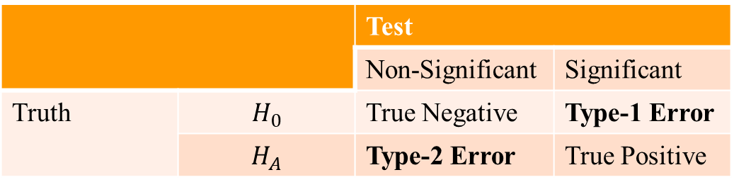
Multiple Comparison Procedure
Several traditional statistical methods were described for testing for an association between a genotype and a trait.
These methods generally require comparing a test statistic to its known (or simulated) distribution in order to quantify the probability of seeing what we do or something more extreme under the assumption that the null hypothesis is true.
Our decision to accept or reject the null then rests on a comparison of this quantity, called the p-value, to a threshold based on a previously determined acceptable level of error.
There are several methods for adjusting for multiple comparisons describes controlling one of two error rates: the family-wise error rate (FWER) and the false discovery rate (FDR).
 |  | Test
 |  | Non-Significant | Significant
Truth | $$H_{0}$$ | True Negative | Type-1 Error
 | $$H_{A}$$ | Type-2 Error | True Positive
Type-1 and type-2 errors in hypothesis testing
Notes:
The genetic material that carries the instructions that allow cells to make proteins
Composed of a sugar phosphate backbone from which four nitrogenous bases- adenine (A), guanine (G), cytosine (C), and thymine (T) protrude
Arranged in a double helix- two strands are held together by specific pairings between bases A – T pair and G – C pair

Slide 43
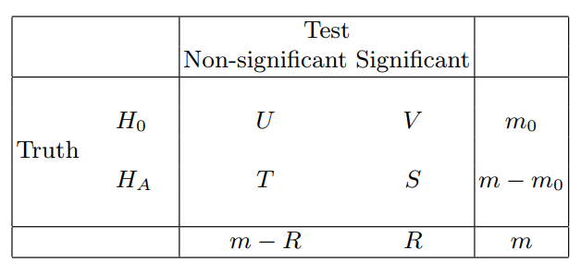

Multiple Comparison Procedure
False Discovery Rate (FDR): defined as the expected proportion of null hypotheses that are true among those that are declared significant.
Returning to the notation of the above Table and assuming R, the number of tests that are declared significant, is greater than 0, FDR is given by
$$FDR=E\left(\frac{V}{R}\right)$$
Errors for multiple hypothesis tests
Notes:
The genetic material that carries the instructions that allow cells to make proteins
Composed of a sugar phosphate backbone from which four nitrogenous bases- adenine (A), guanine (G), cytosine (C), and thymine (T) protrude
Arranged in a double helix- two strands are held together by specific pairings between bases A – T pair and G – C pair

Slide 44

Multiple Comparison Procedure
For R = 0, we define the ratio V=R as identically equal to 0 since no false rejections can occur.
The FDR can therefore be expressed equivalently as
$$FDR=E\left(V/R|R>0\right)\operatorname{Pr}\left(R>0\right)+E\left(V/R|R=0\right)\operatorname{Pr}\left(R=0\right)$$
$$=E\left(V/R|R>0\right)\operatorname{Pr}{(R>0)}$$
Notes:
The genetic material that carries the instructions that allow cells to make proteins
Composed of a sugar phosphate backbone from which four nitrogenous bases- adenine (A), guanine (G), cytosine (C), and thymine (T) protrude
Arranged in a double helix- two strands are held together by specific pairings between bases A – T pair and G – C pair

Slide 45
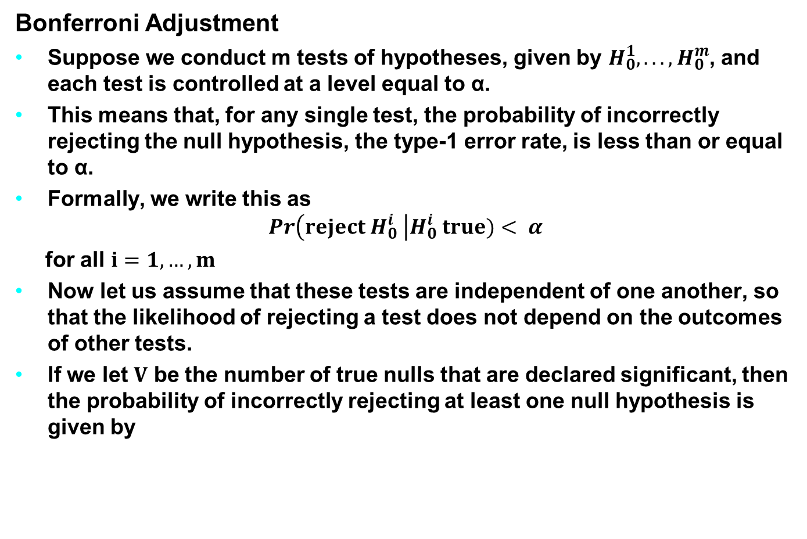
Multiple Comparison Procedure
Bonferroni Adjustment
Suppose we conduct m tests of hypotheses, given by $H_{0}^{1}, . . . , H_{0}^{m}$, and each test is controlled at a level equal to α.
This means that, for any single test, the probability of incorrectly rejecting the null hypothesis, the type-1 error rate, is less than or equal to α.
Formally, we write this as
$$\operatorname{Pr}\left(reject H_{0}^{i} \right|H_{0}^{i} true)< α$$
for all $i=1, …, m$
Now let us assume that these tests are independent of one another, so that the likelihood of rejecting a test does not depend on the outcomes of other tests.
If we let $V$ be the number of true nulls that are declared significant, then the probability of incorrectly rejecting at least one null hypothesis is given by
Notes:
The genetic material that carries the instructions that allow cells to make proteins
Composed of a sugar phosphate backbone from which four nitrogenous bases- adenine (A), guanine (G), cytosine (C), and thymine (T) protrude
Arranged in a double helix- two strands are held together by specific pairings between bases A – T pair and G – C pair

Slide 46
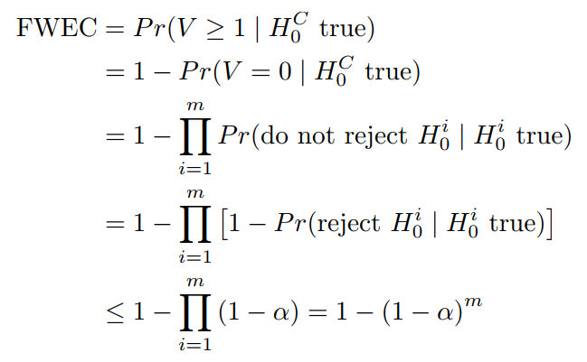
Multiple Comparison Procedure
Notably, if m = 1, then this equation reduces to FWEC ≤ α.
However, if m = 2 independent tests are performed, each at level α = 0:05, then we are only certain that the probability of making at least one type-1 error is less than or equal to 1 - (1 - 0:05)2 = 0:0975.
Notes:
The genetic material that carries the instructions that allow cells to make proteins
Composed of a sugar phosphate backbone from which four nitrogenous bases- adenine (A), guanine (G), cytosine (C), and thymine (T) protrude
Arranged in a double helix- two strands are held together by specific pairings between bases A – T pair and G – C pair

Slide 47

Multiple Comparison Procedure
The Bonferroni adjustment for multiple comparisons is a single-step procedure and probably the most straightforward adjustment to apply.
It involves simply using $α^{′}$ = α/m in place of α for the level of each test, where m is the number of tests to be performed.
Notes:
The genetic material that carries the instructions that allow cells to make proteins
Composed of a sugar phosphate backbone from which four nitrogenous bases- adenine (A), guanine (G), cytosine (C), and thymine (T) protrude
Arranged in a double helix- two strands are held together by specific pairings between bases A – T pair and G – C pair

Slide 48
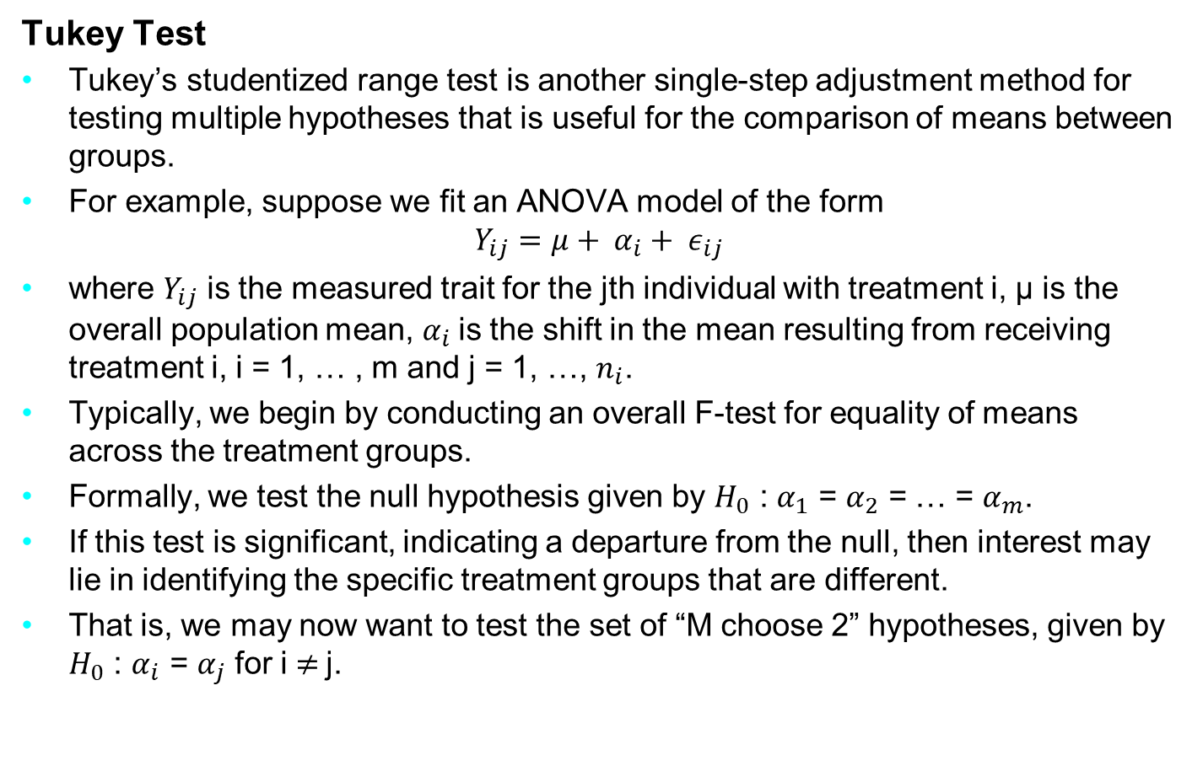
Multiple Comparison Procedure
Tukey Test
Tukey’s studentized range test is another single-step adjustment method for testing multiple hypotheses that is useful for the comparison of means between groups.
For example, suppose we fit an ANOVA model of the form
$$Y_{ij}=μ+ α_{i}+ ε_{ij}$$
where $Y_{ij}$ is the measured trait for the jth individual with treatment i, µ is the overall population mean, $α_{i}$is the shift in the mean resulting from receiving treatment i, i = 1, … , m and j = 1, …, $n_{i}$.
Typically, we begin by conducting an overall F-test for equality of means across the treatment groups.
Formally, we test the null hypothesis given by $H_{0}$ : $α_{1}$ = $α_{2}$ = … = $α_{m}$.
If this test is significant, indicating a departure from the null, then interest may lie in identifying the specific treatment groups that are different.
That is, we may now want to test the set of “M choose 2” hypotheses, given by $H_{0}$ : $α_{i}$ = $α_{j}$ for i $≠$j.
Notes:
The genetic material that carries the instructions that allow cells to make proteins
Composed of a sugar phosphate backbone from which four nitrogenous bases- adenine (A), guanine (G), cytosine (C), and thymine (T) protrude
Arranged in a double helix- two strands are held together by specific pairings between bases A – T pair and G – C pair

Slide 49
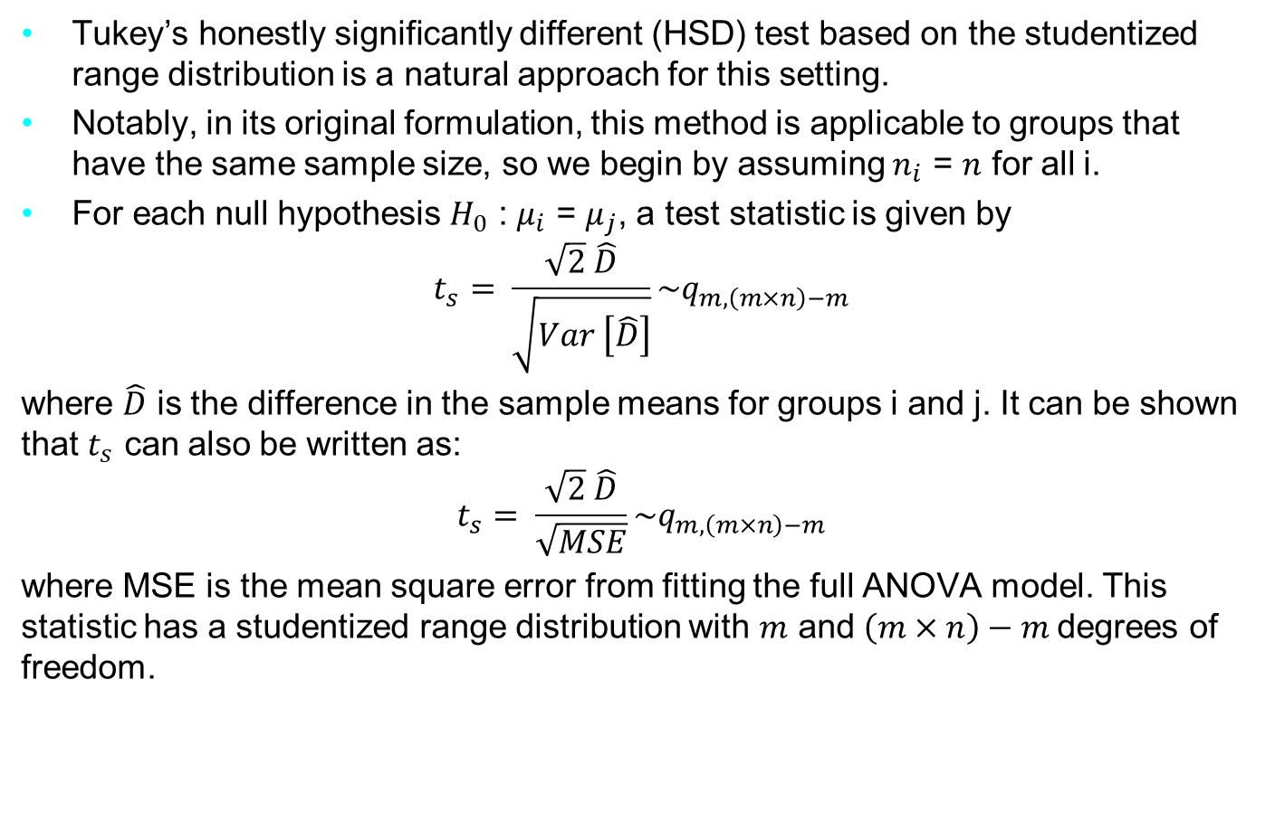
Multiple Comparison Procedure
Tukey’s honestly significantly different (HSD) test based on the studentized range distribution is a natural approach for this setting.
Notably, in its original formulation, this method is applicable to groups that have the same sample size, so we begin by assuming $n_{i}$ = $n$ for all i.
For each null hypothesis $H_{0}$ : $μ_{i}$ = $μ_{j}$, a test statistic is given by
$$t_{s}= \frac{\sqrt{2} \hat{D}}{\sqrt{Var \left[\hat{D}\right]}}\sim q_{m, \left(m×n\right)−m}$$
where $\hat{D}$ is the difference in the sample means for groups i and j. It can be shown that $t_{s}$ can also be written as:
$$t_{s}= \frac{\sqrt{2} \hat{D}}{\sqrt{MSE}}\sim q_{m, \left(m×n\right)−m}$$
where MSE is the mean square error from fitting the full ANOVA model. This statistic has a studentized range distribution with $m$ and $\left(m×n\right)−m$degrees of freedom.
Notes:
The genetic material that carries the instructions that allow cells to make proteins
Composed of a sugar phosphate backbone from which four nitrogenous bases- adenine (A), guanine (G), cytosine (C), and thymine (T) protrude
Arranged in a double helix- two strands are held together by specific pairings between bases A – T pair and G – C pair

